Slide 1
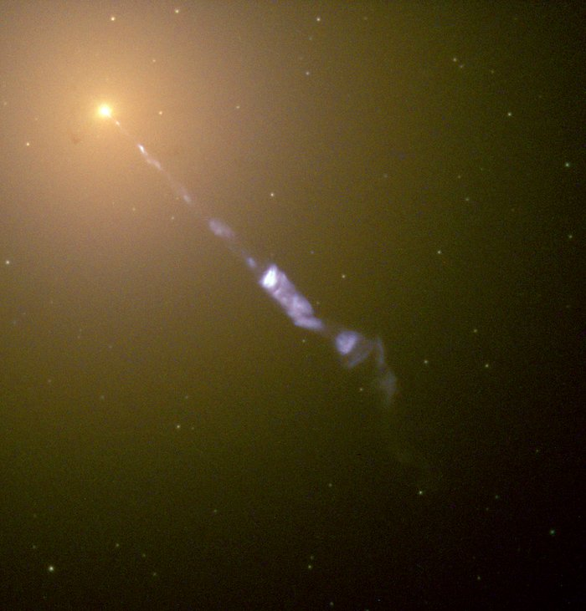



Investigating Supermassive Black Holes and Their Variability Using Structure Functions
By Derek Blue
Co-Supervised by Dr. Tina Harriott and Dr. Luigi Gallo
Image Credit: http://hubblesite.org/image/968/news_release/2000-20

Slide 2
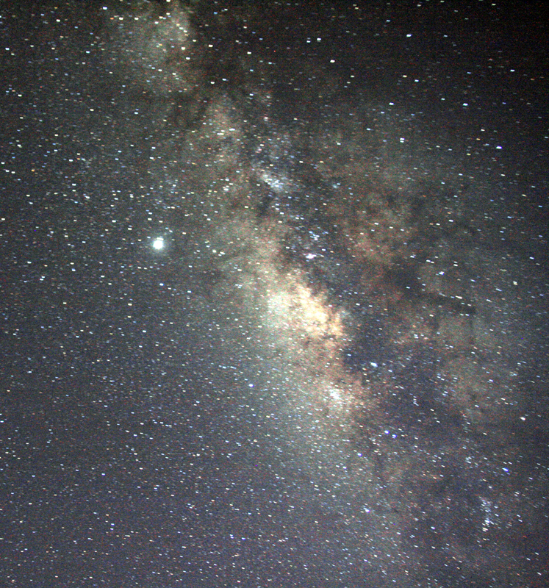
A brief introduction to the universe
This Photo by Unknown Author is licensed under CC BY-SA
Populated by Gas, Dust, and Stars
Collections of gas, dust, and stars called galaxies
Galaxies come in all shapes and sizes

Slide 3
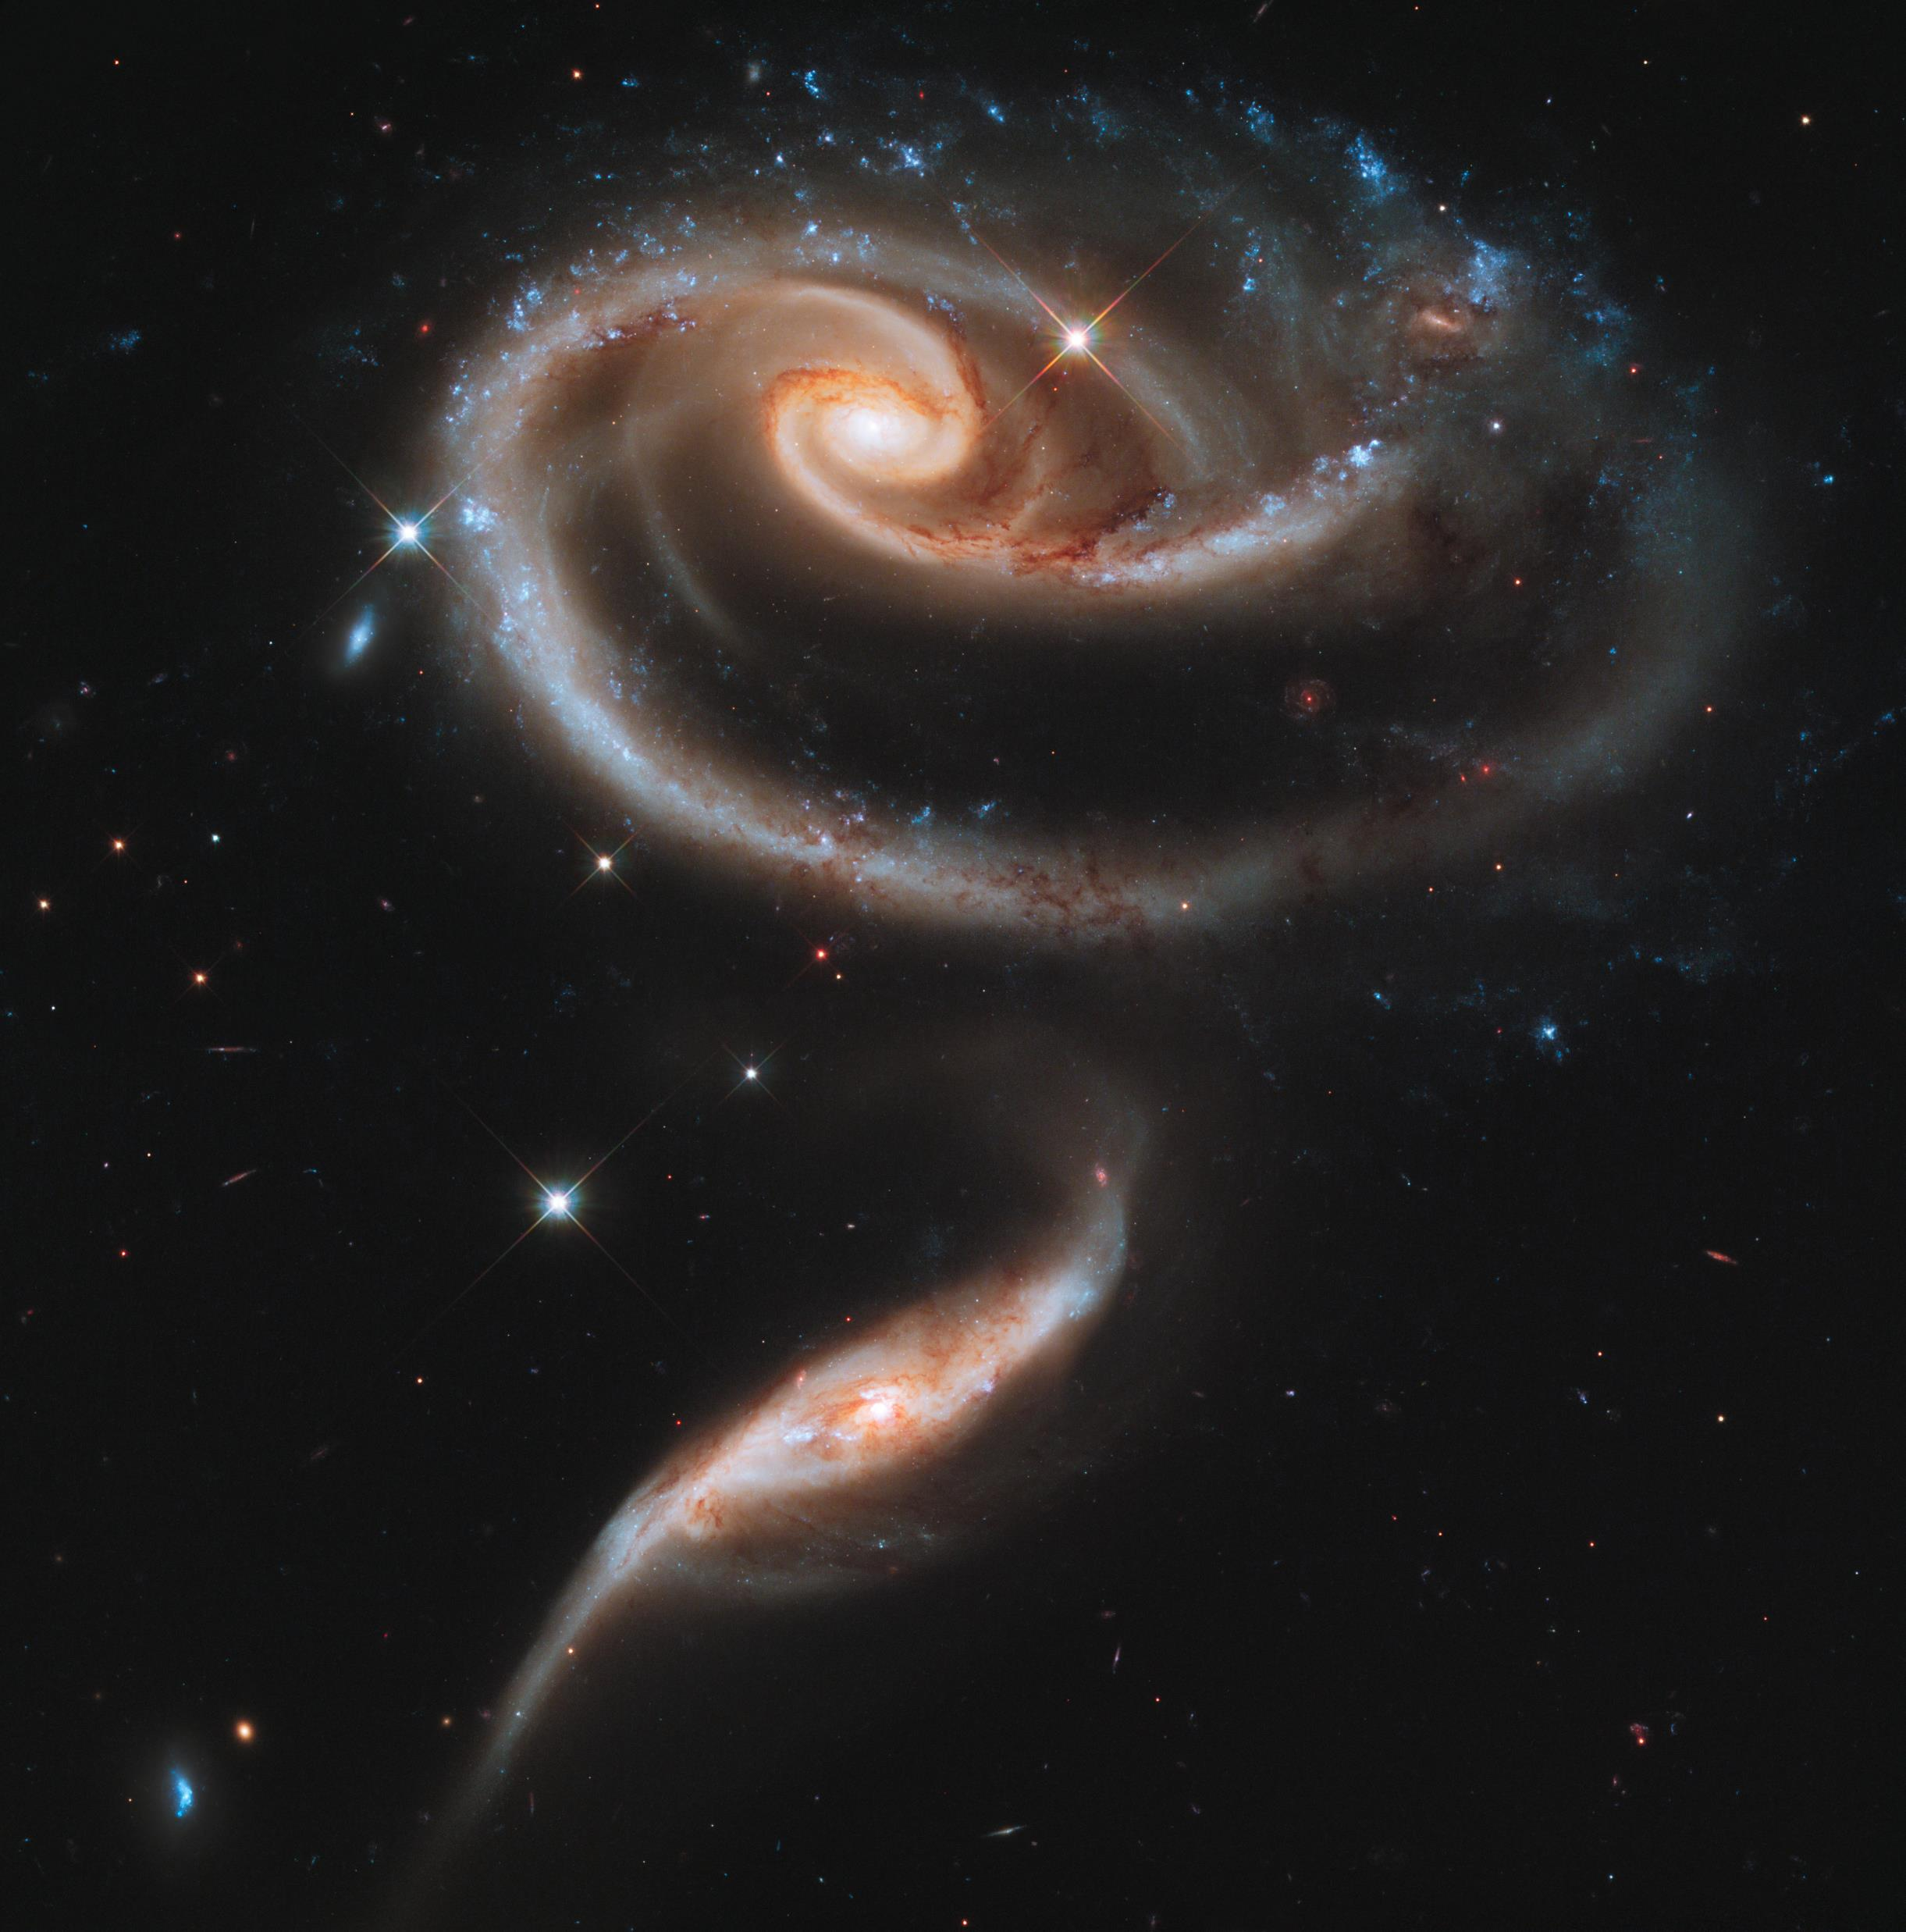
Relatively dim compared to stars
Originally described as “great clouds of stars”
Broken into three main groups
Hosts to supermassive black holes in their centers
Galaxies
Image Credit: ESA/Hubble & NASA - https://www.spacetelescope.org/images/heic1107a/

Slide 4
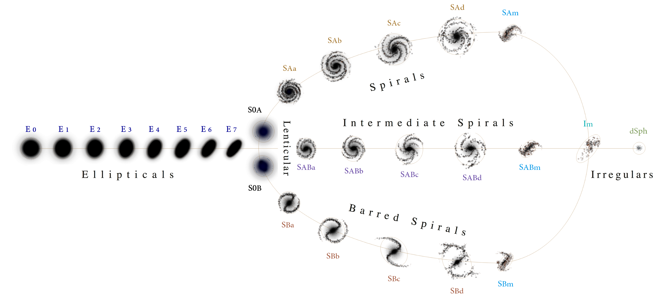
Galaxy Classification
Image Credit: https://commons.wikimedia.org/wiki/File:Hubble\_\_de\_Vaucouleurs\_Galaxy\_Morphology\_Diagram.png

Slide 5

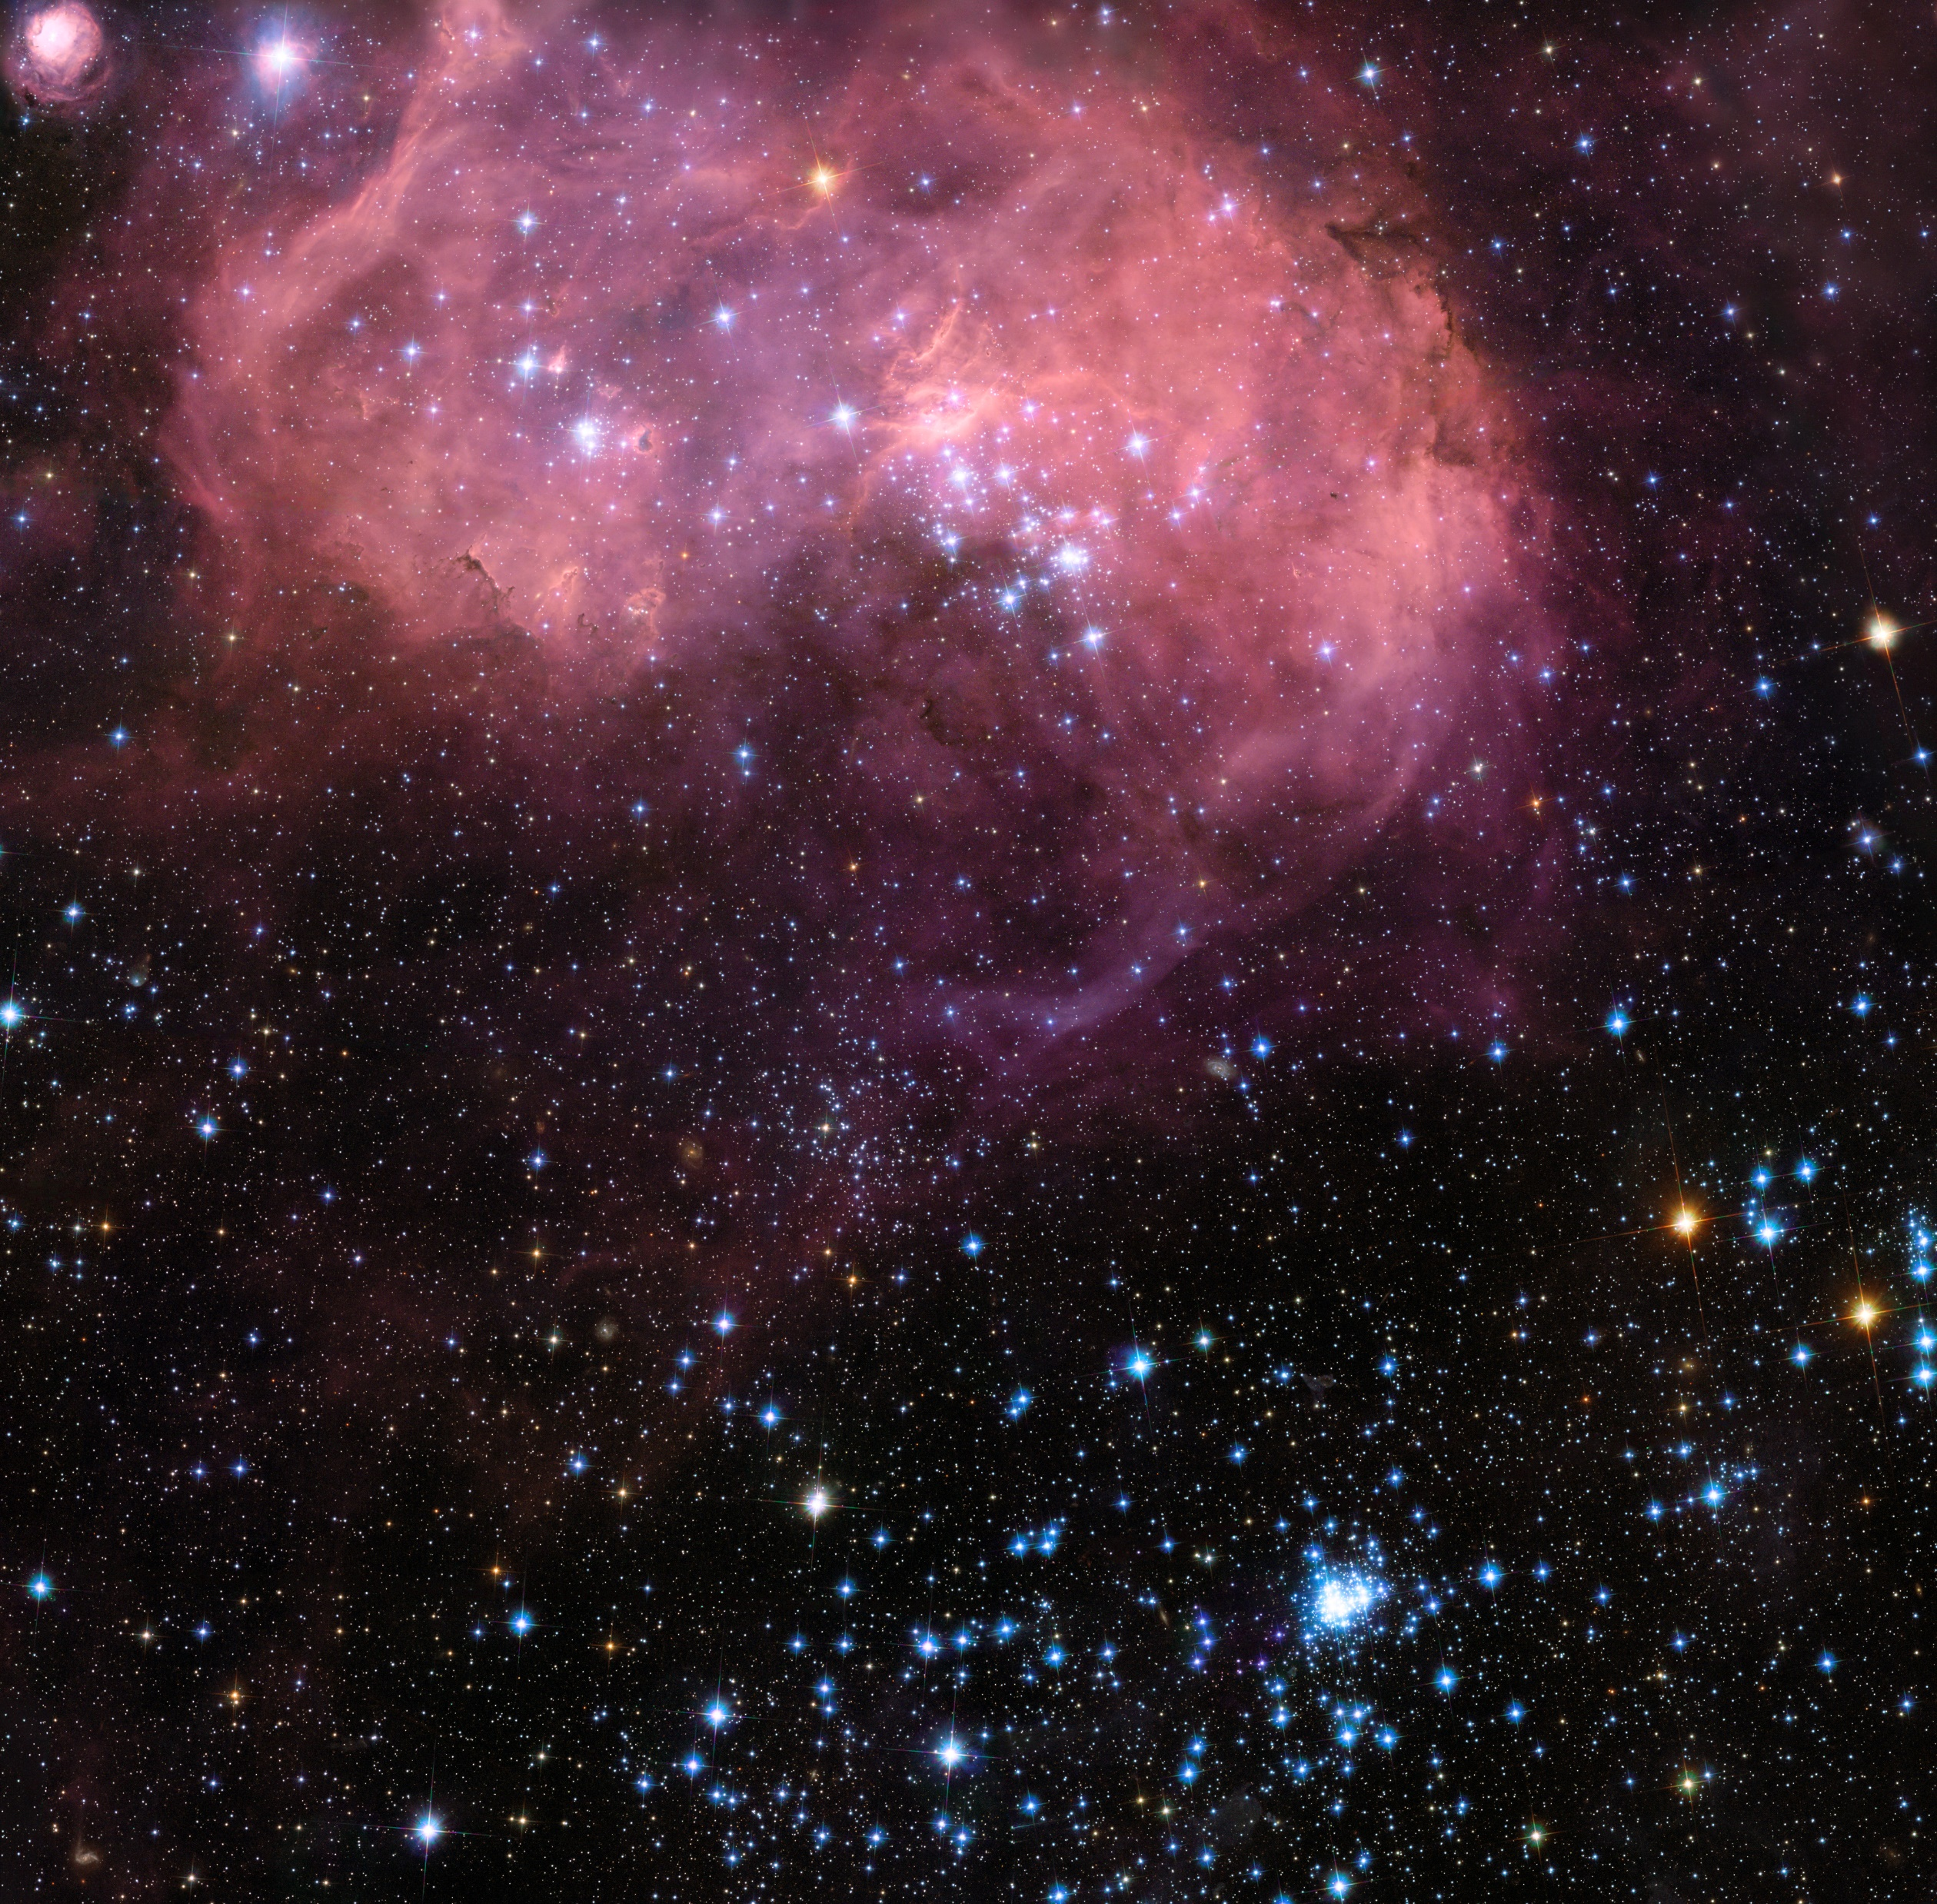
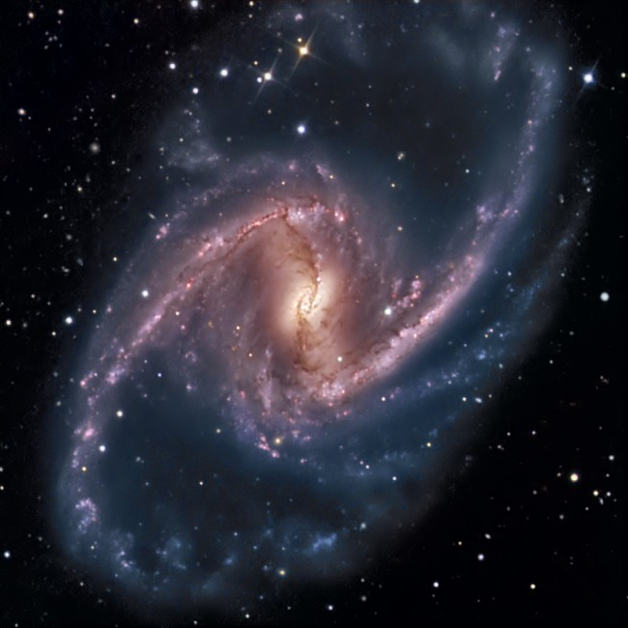
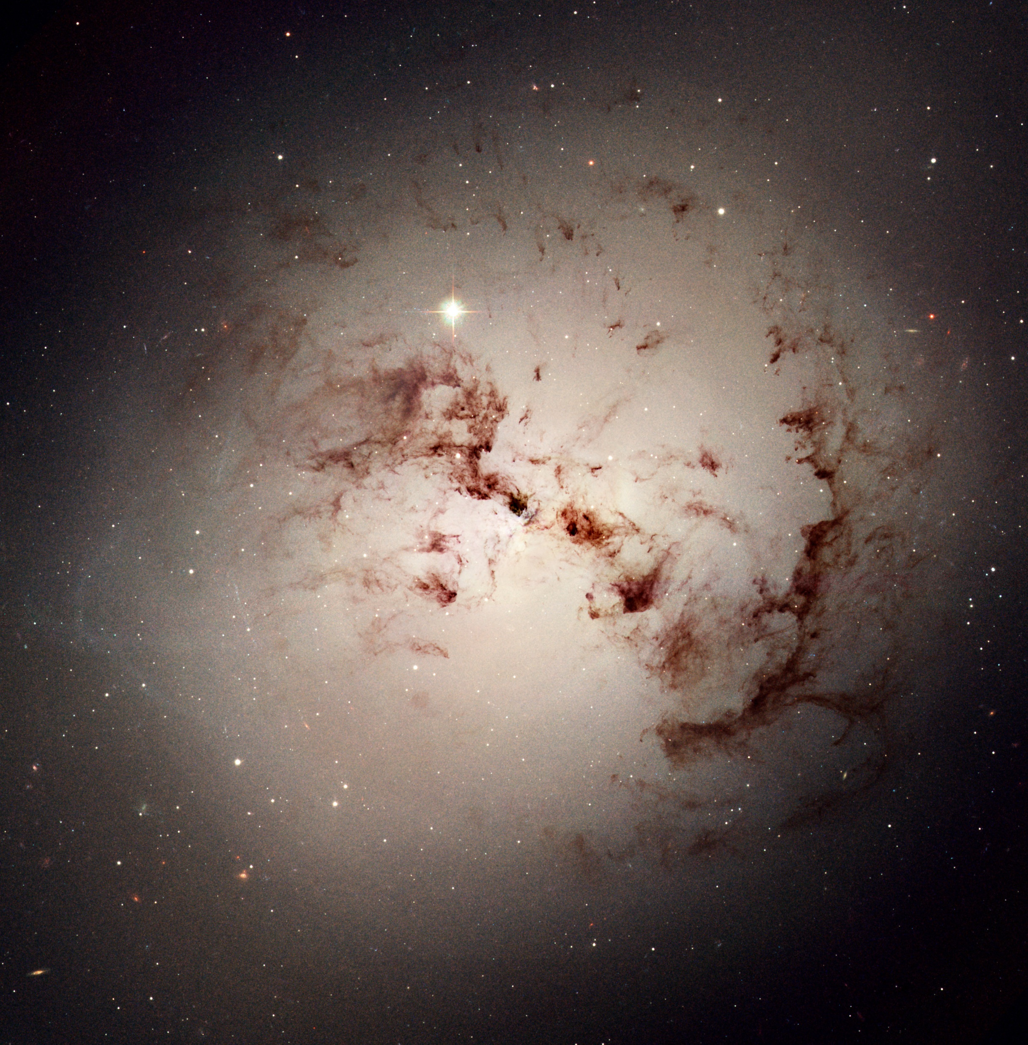
NGC 1316
Large Magellanic Cloud
NGC 1365
Galaxy Examples
Image Credits: ESA/Hubble & NASA - https://www.spacetelescope.org

Slide 6

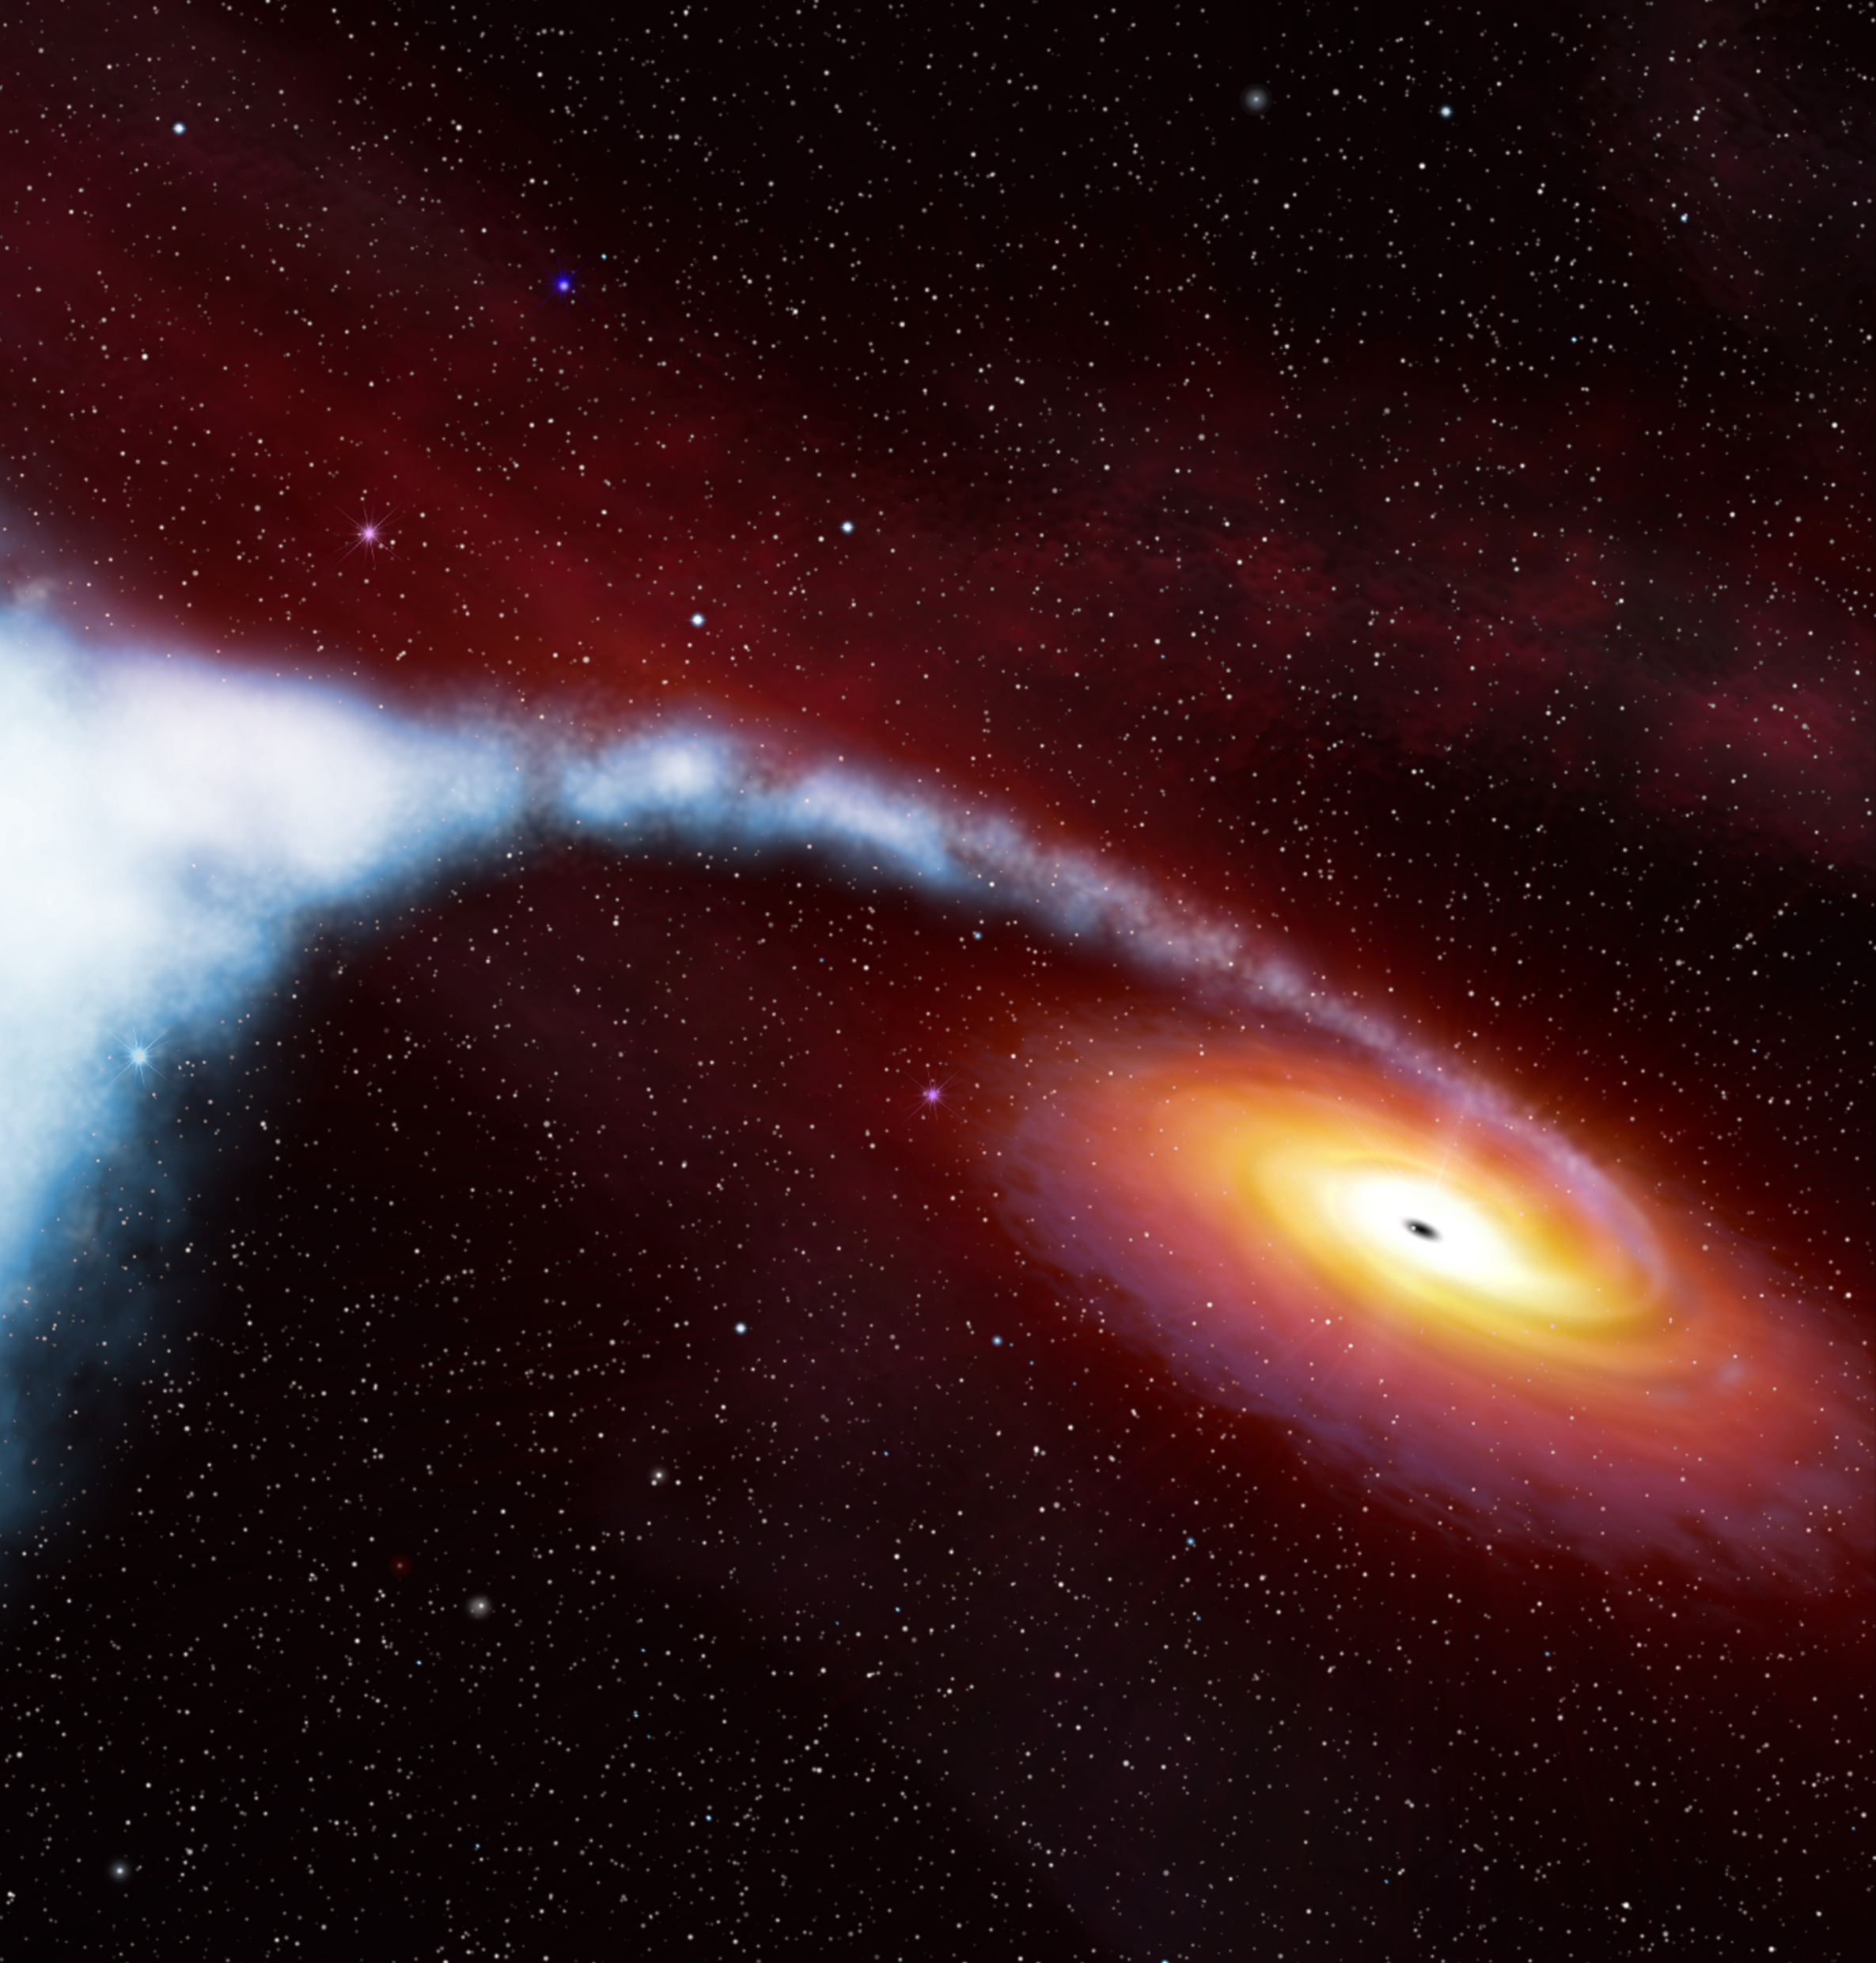
Black Holes
Massive enough to affect light
Named for their regions inside which light cannot escape
Image Credit: ESA/Hubble & NASA - https://www.spacetelescope.org/images/cygx1\_illust\_orig/

Slide 7
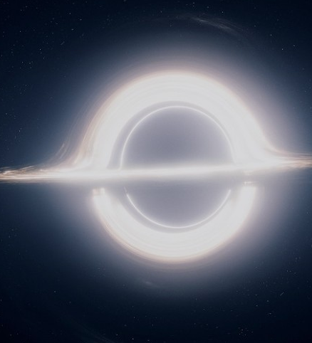
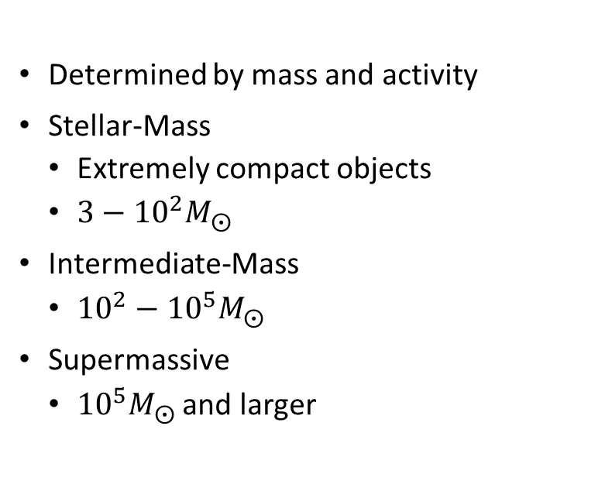
Types Of Black Holes
Image Credit: https://static.interestingengineering.com/images/uploads/sizes/interstellar_resize_md.jpg
Determined by mass and activity
Stellar-Mass
Extremely compact objects
$3−{10}^{2}M_{⨀}$
Intermediate-Mass
${10}^{2}−{10}^{5}M_{⨀}$
Supermassive
${10}^{5}M_{⨀}$ and larger

Slide 8
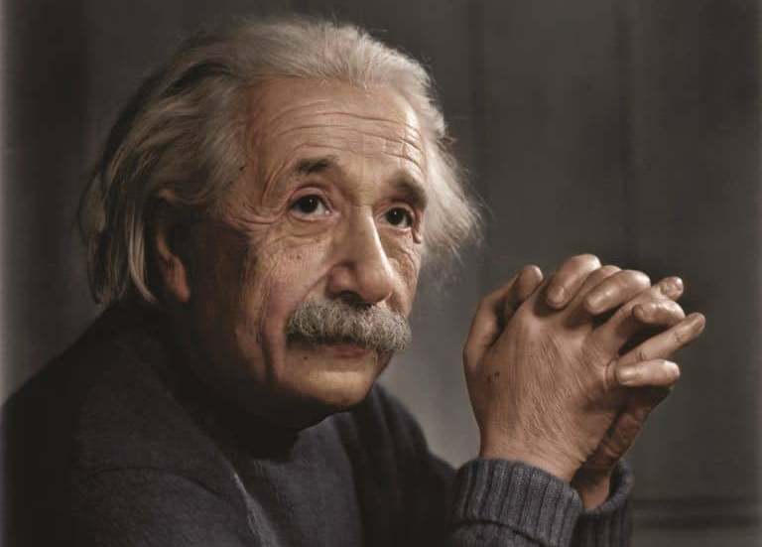
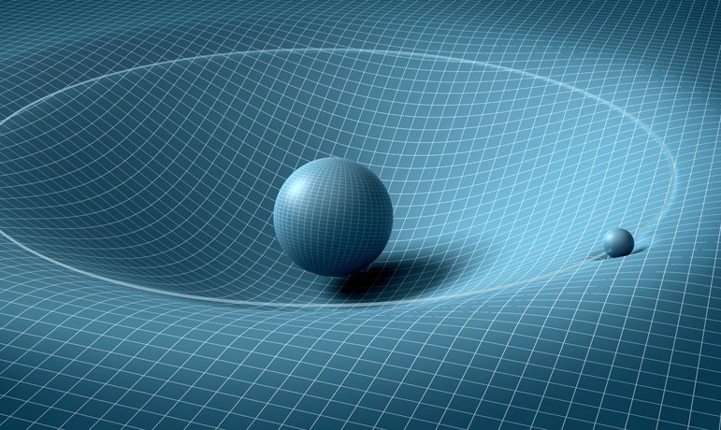
General Relativity
Introduced by Einstein in 1915 to address flaws in Newtonian mechanics
Solutions describe black holes, universe expansion, and many other phenomenon
Replaces Newtons forces with the theory that particles and photons travel along paths through curved spacetime
Curvature of spacetime caused by matter
Solutions determined by the metric tensor
Image Credit: https://cdn-images-1.medium.com/max/1000/1*H2TOpTVla4VCsGVuS2enAQ.jpeg
Image Credit: https://cdn.insidetheperimeter.ca/wp-content/uploads/2015/11/Albert_einstein_by_zuzahin-d5pcbug-WikiCommons-768x706.jpg

Slide 9

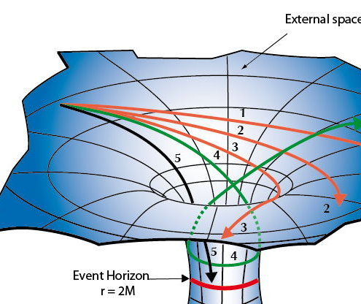
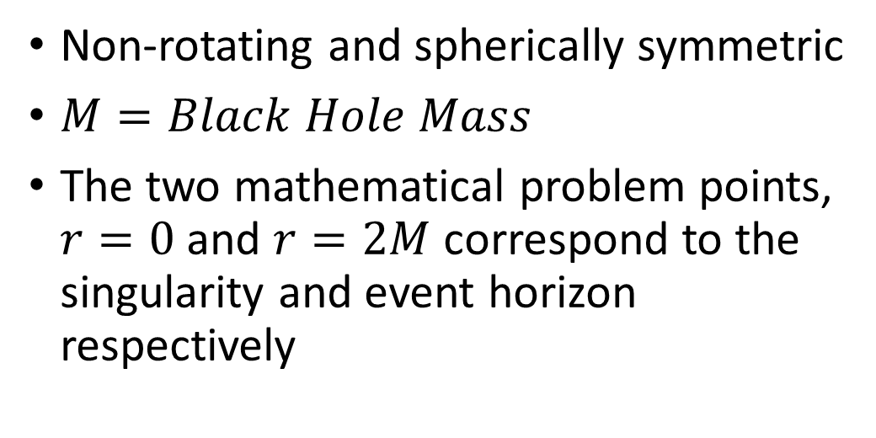
Schwarzschild Solution
Non-rotating and spherically symmetric
$M=Black Hole Mass$
The two mathematical problem points, $r=0$ and $r=2M$ correspond to the singularity and event horizon respectively
Image Credit: https://weinsteing.wordpress.com/2017/12/14/the-geodesics-of-the-schwarzschild-metric-3/

Slide 10
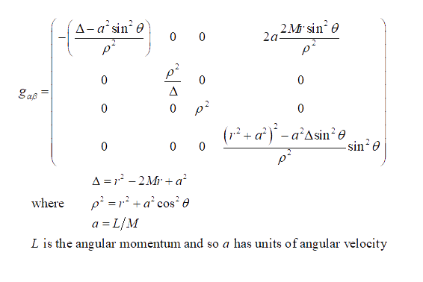

Kerr Solution
Rotating axially symmetric black hole solution
Ring singularity instead of a point singularity when $ρ=0$
Solution has two event horizons
$Δ=0$ at $r_{±}=M±\sqrt{M^{2}−a^{2}}$
Solution has two surfaces of infinite redshift inside which all particles and photons must rotate with the black hole
$r_{s±}=M±\sqrt{M^{2}−a^{2}\cos^{2}θ}$

Slide 11
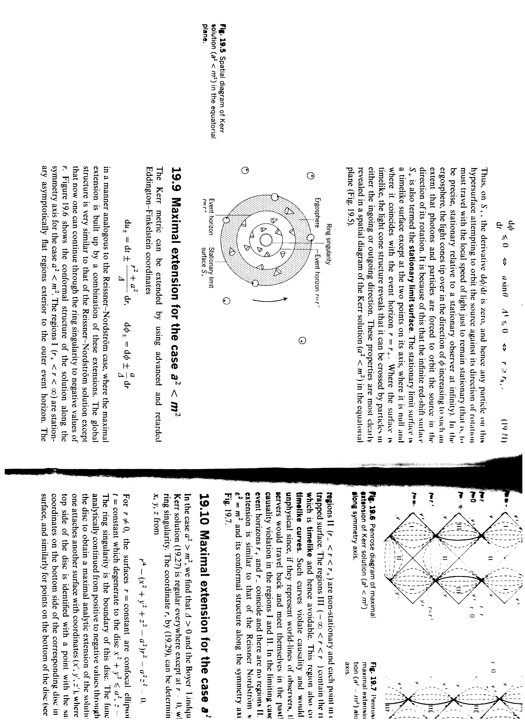
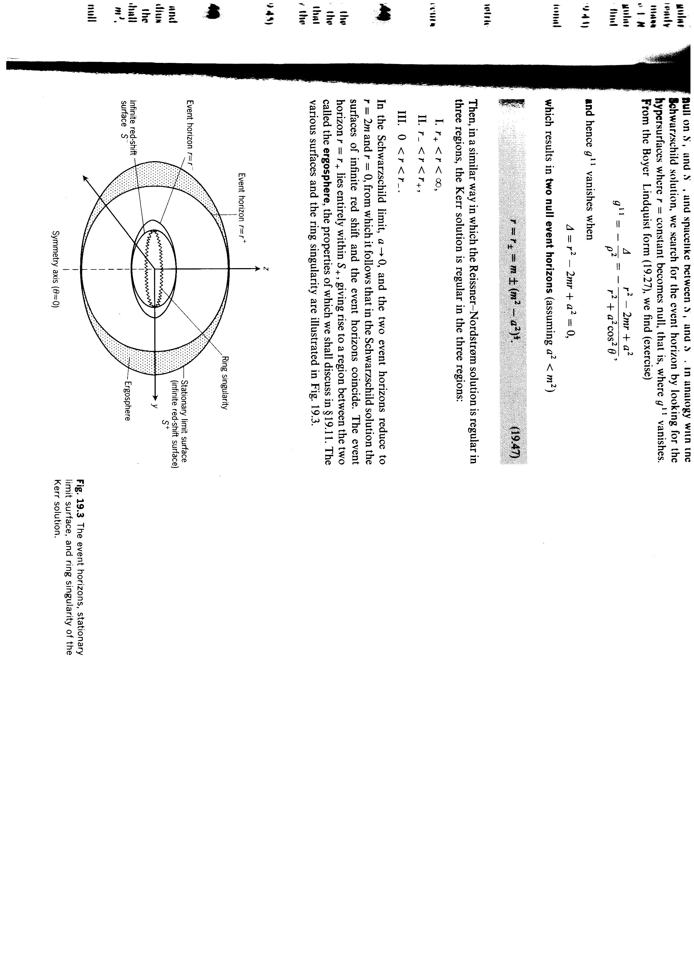
Kerr Solution Structure
The region between the surfaces of infinite redshift and the event horizon is called the ergosphere where particles and photons must rotate with the black hole.
Credit: d’Inverno, R. (1993)
Credit: d’Inverno, R. (1993)

Slide 12
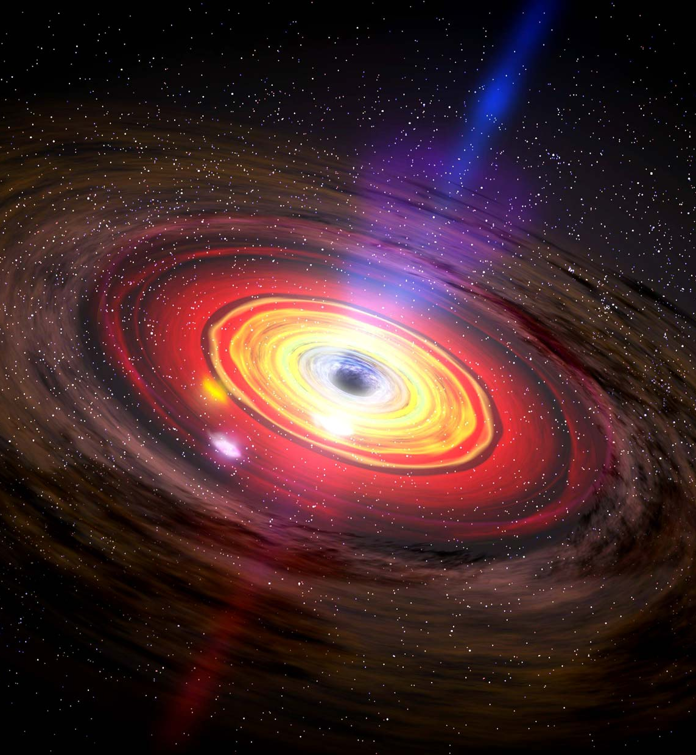
Image Credit: https://www.britannica.com/science/black-hole/media/67925/196036
Active Galaxies
Extremely bright centers
Hosts to supermassive black holes
Central black hole actively accreting
Highly variable spectra
Central engines called Active Galactic Nuclei (AGN)

Slide 13
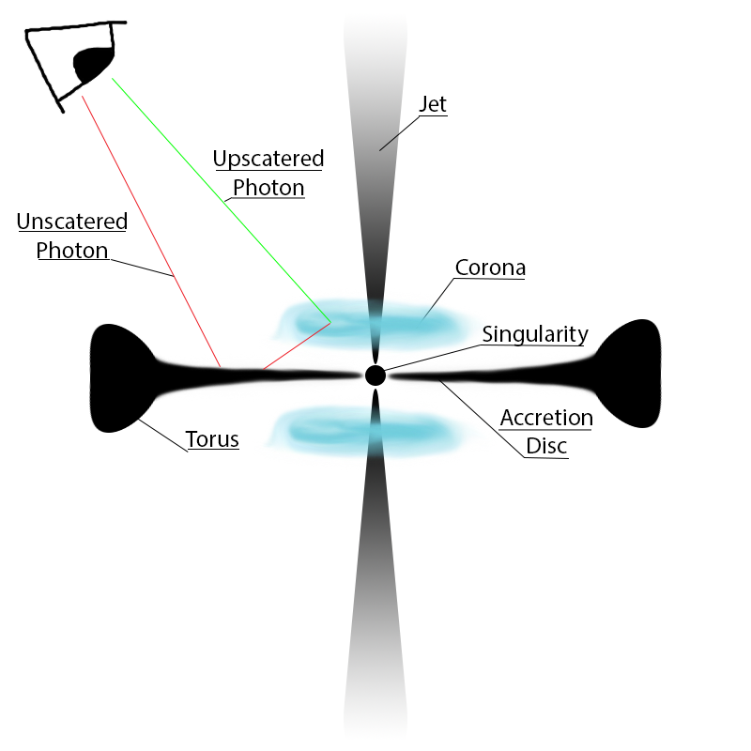
How we see AGN
Accretion disc heats matter to the point it emits UV light
Clouds of electrons stripped from the accretion disc form above and below called the corona
UV light entering the corona is up scattered to X-ray and gamma ray through Compton scattering process

Slide 14
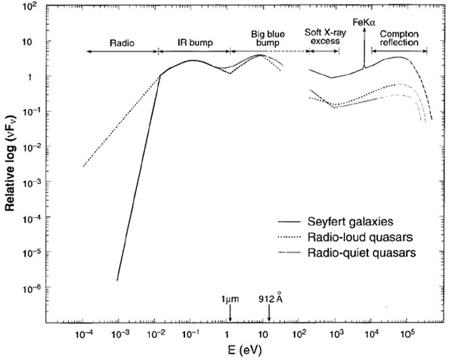
AGN Emission Spectra
Relatively flat spectra
Telescopes record individual photon energy
Photon counts sorted by energy level
Image Credit: https://ned.ipac.Caltech.edu/level5/Sept04/Koratkar/Koratkar1.html

Slide 15
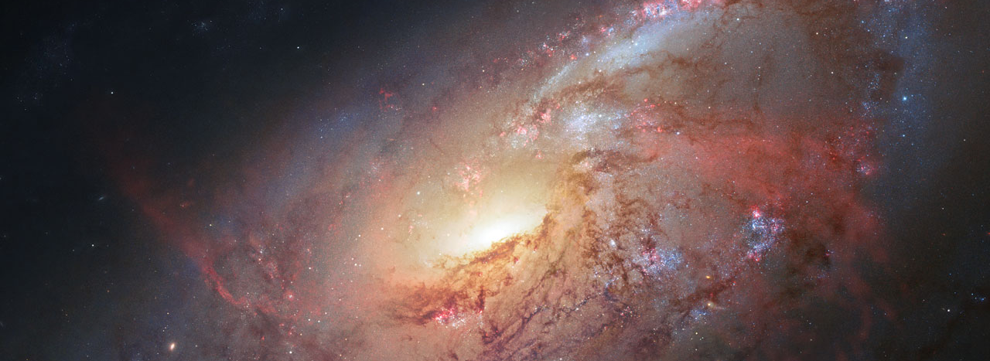
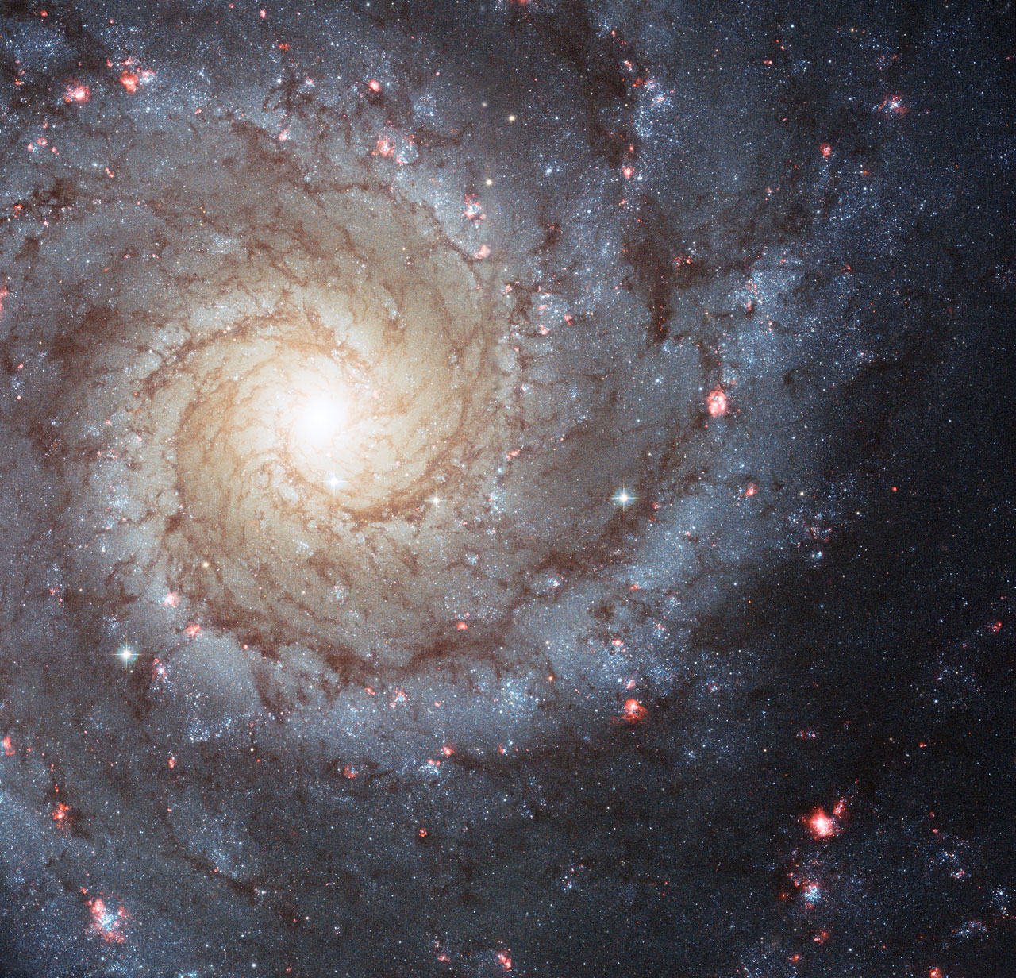
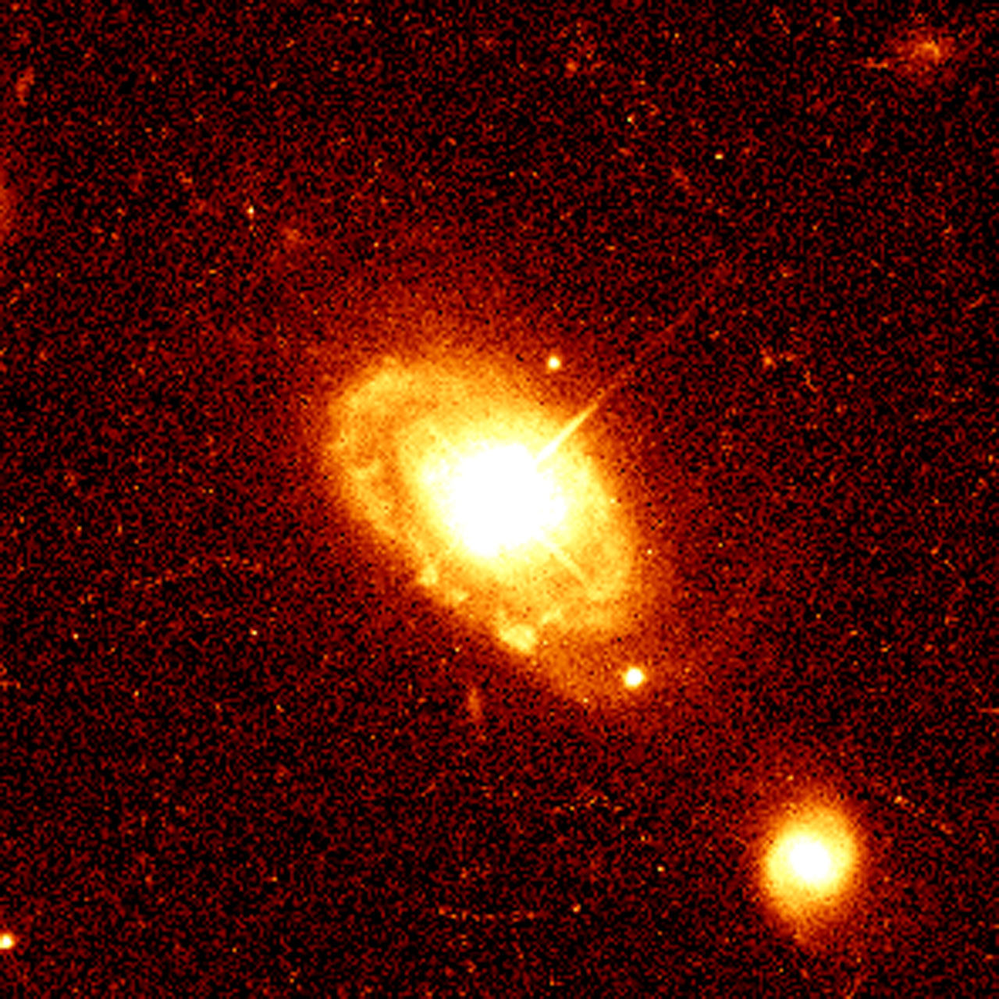
Types of AGN
Image Credits: ESA/Hubble & NASA - https://www.spacetelescope.org
Seyfert Galaxy
Blazars
Quasars
Seyfert Galaxies
Seyfert 1
Seyfert 2
Quiescent Galaxy
Quasar

Slide 16
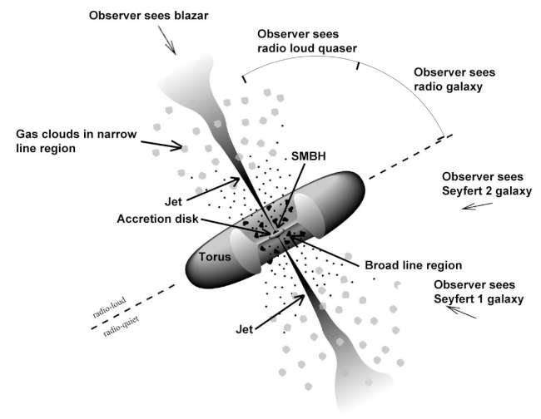
The Unified Model
AGN brightness attributed to accretion
Viewing angle affects spectral energy distribution
Type of AGN determined by viewing angle
Image Credit: https://fermi.gsfc.nasa.gov/science/eteu/agn/figure1.jpg

Slide 17
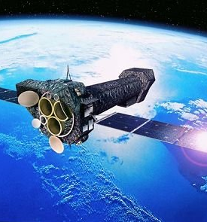
Image Credit: ESA https://www.esa.int/spaceinimages/Images/2000/11/XMM-Newton_artist_s_impression
How AGN are Observed
AGN are observed indirectly
The process of accretion causes large amounts of UV and X-ray emission
Satellite telescopes are used due to atmospheric absorption

Slide 18
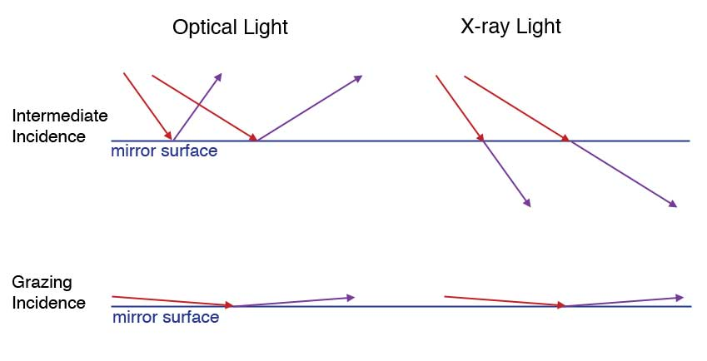
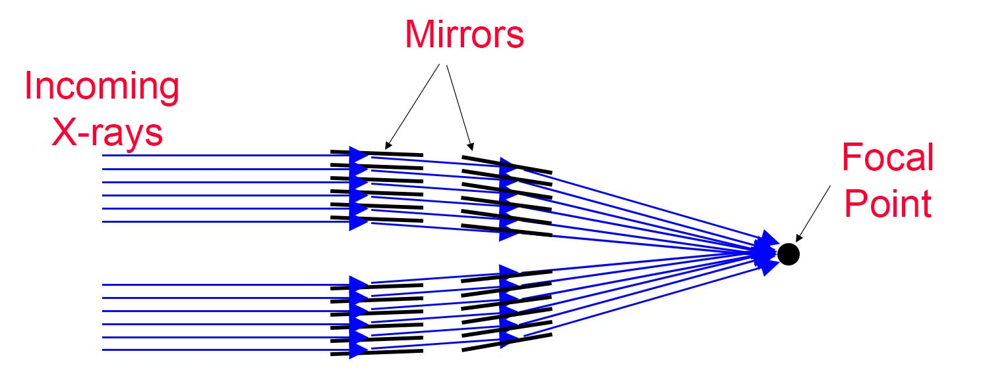
How AGN are Observed
X-rays cannot be captured like optical light
Process known as grazing incidence used
X-ray telescopes employ many mirrors
Image Credits: https://imagine.gsfc.nasa.gov/observatories/technology/xray telescopes1.html

Slide 19
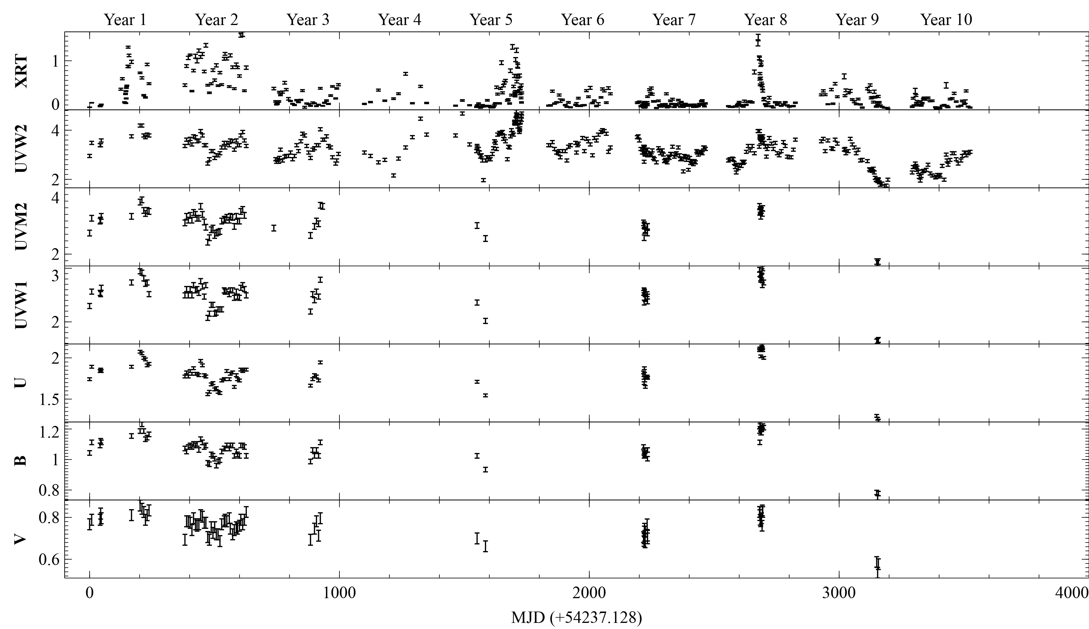
Mkn 335 Lightcurves
11 year monitoring campaign with Swift
X-ray and UVW2 filters have best sampling
Highly broken data
Gallo, L., Blue, D.M. et al 2018

Slide 20
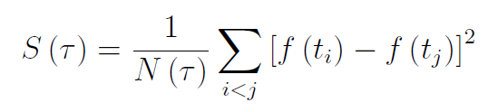
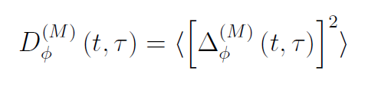
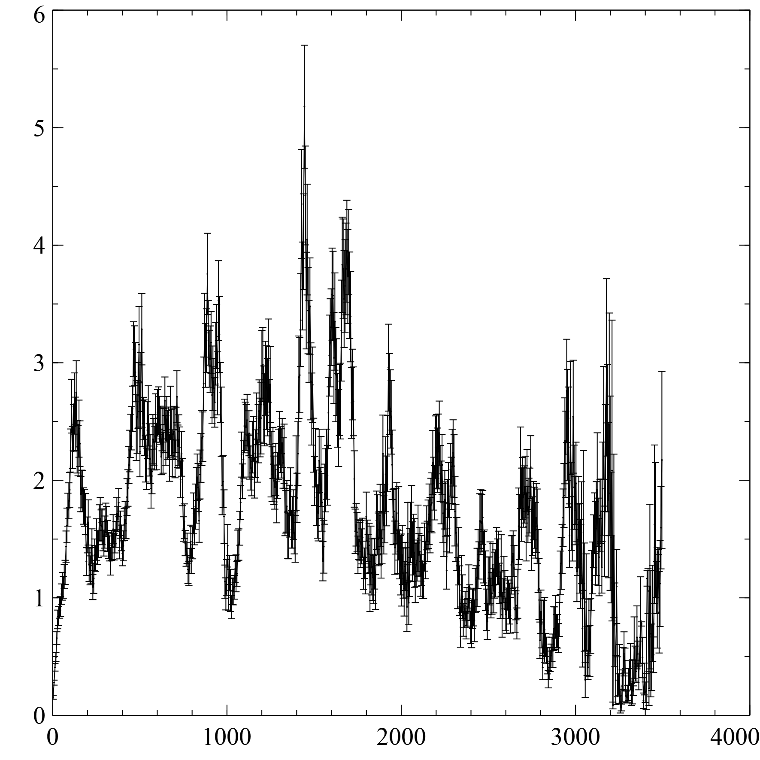
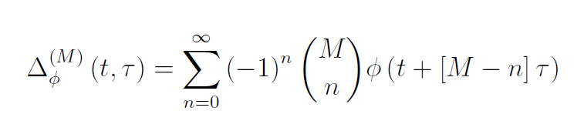
Structure Function
Mth order structure function removes (M – 1) order polynomials
Removes any non-stationary random processes
Remains in the time domain
Gallo, L., Blue, D.M. et al 2018

Slide 21
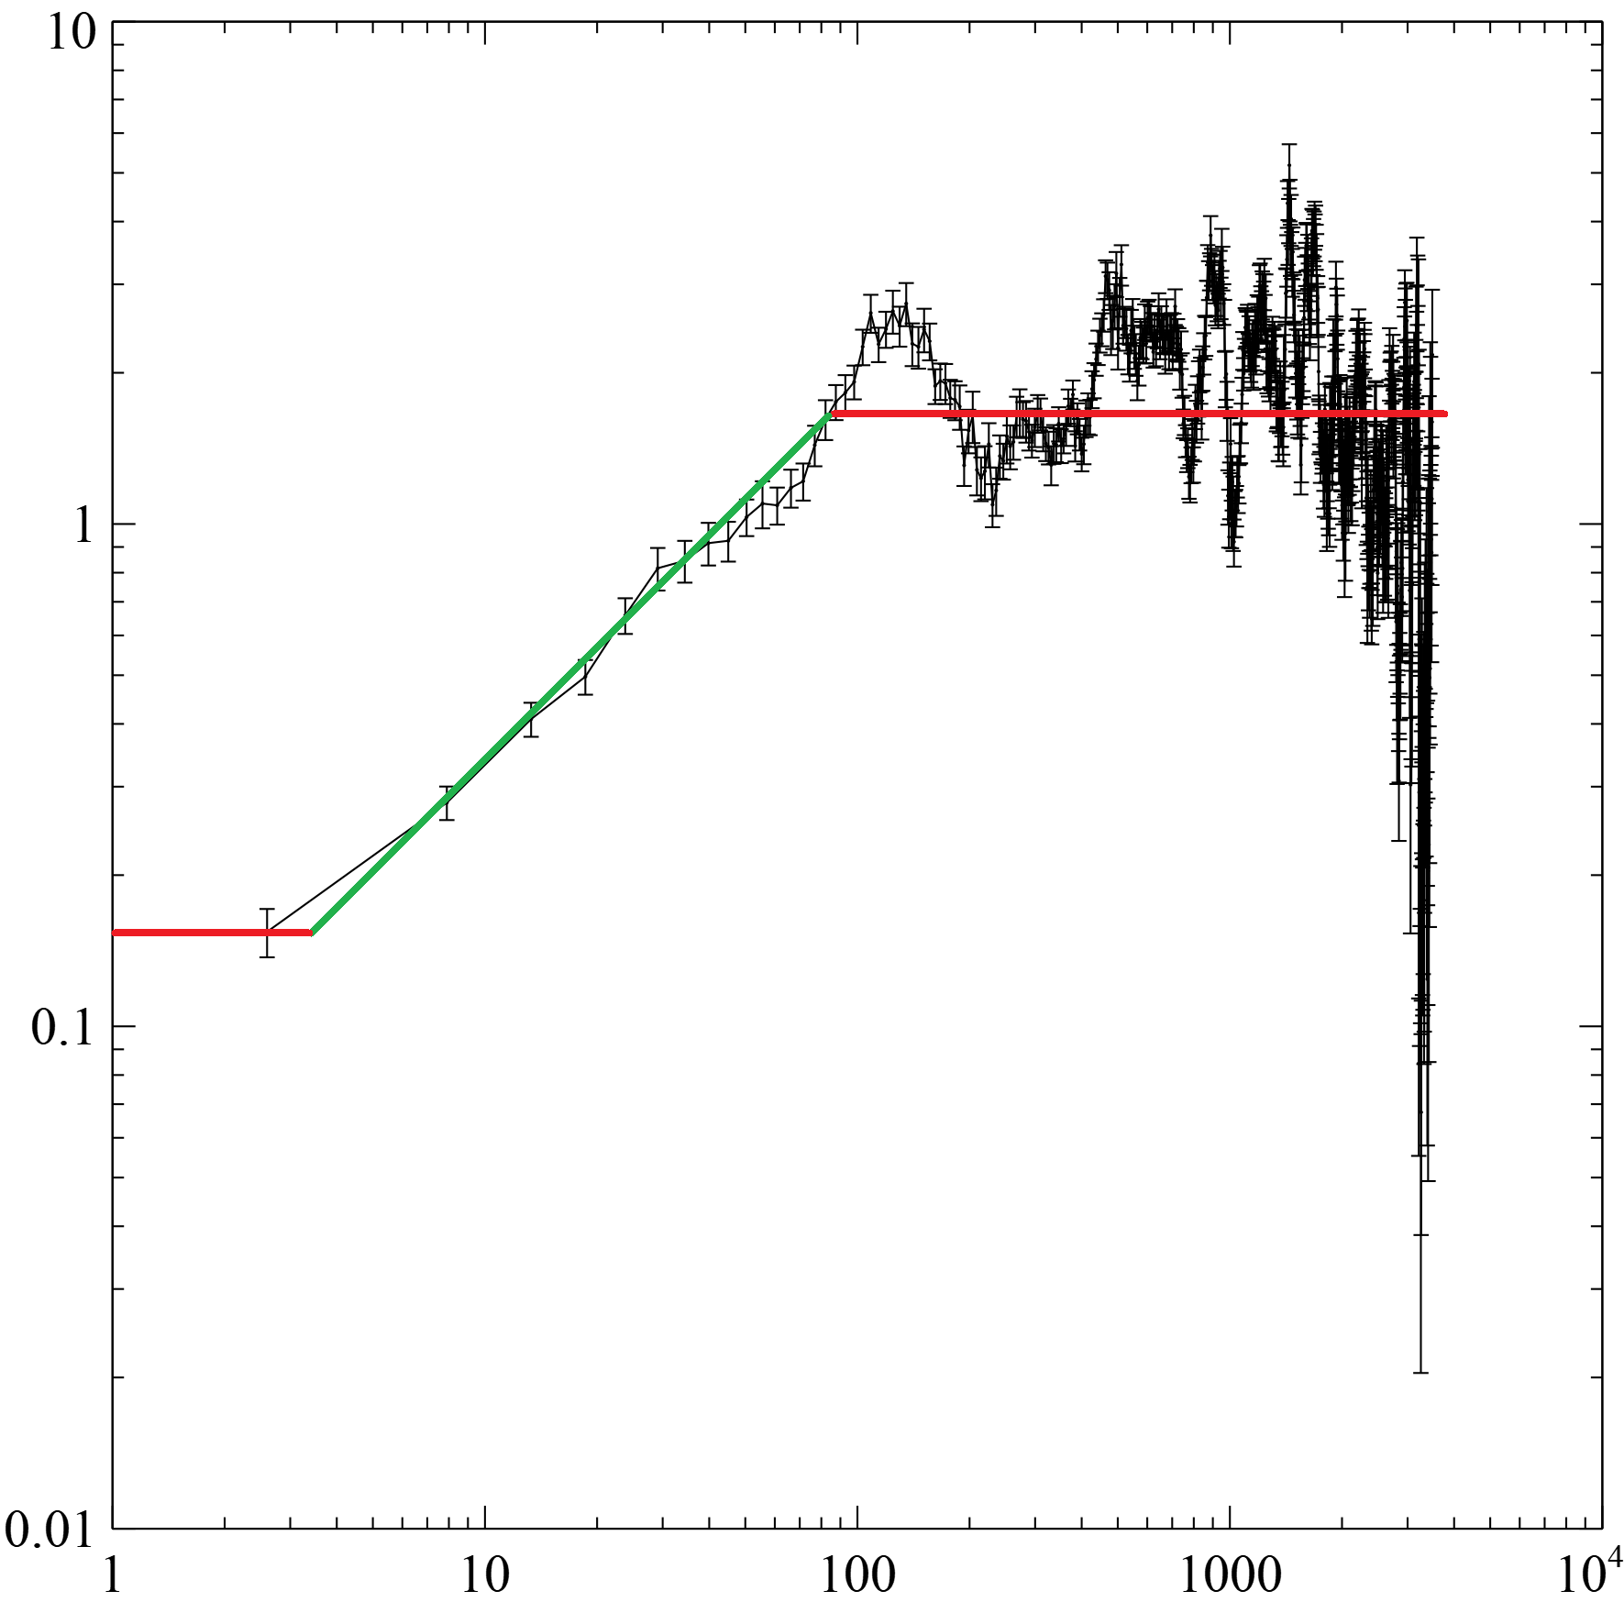

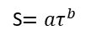
Structure Function
S$={aτ}^{b}$
Linear trends artificially steepen the structure function
Takes the shape of a sigmoid
Connecting region can be fit with a power law model $S={aτ}^{b}$
Related to power-density spectrum via $α=b+1$
Generally Visualized on log scaled axes
Gallo, L., Blue, D.M. et al 2018

Slide 22




Writing a Structure Function Program
Written in C++
Consists several custom libraries
More features being added
Publicly available on GitHub
https://github.com/Starkiller4011/SFA

Slide 23
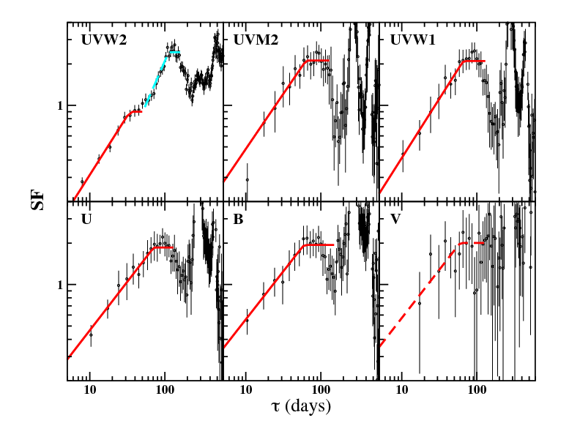
Mkn 335 Results
Structure functions for the optical and UV
V band unable to be constrained
UVW2 demonstrates broken power law section, potential indication for two distinct slopes and characteristic timescales
Gallo, L., Blue, D.M. et al 2018

Slide 24
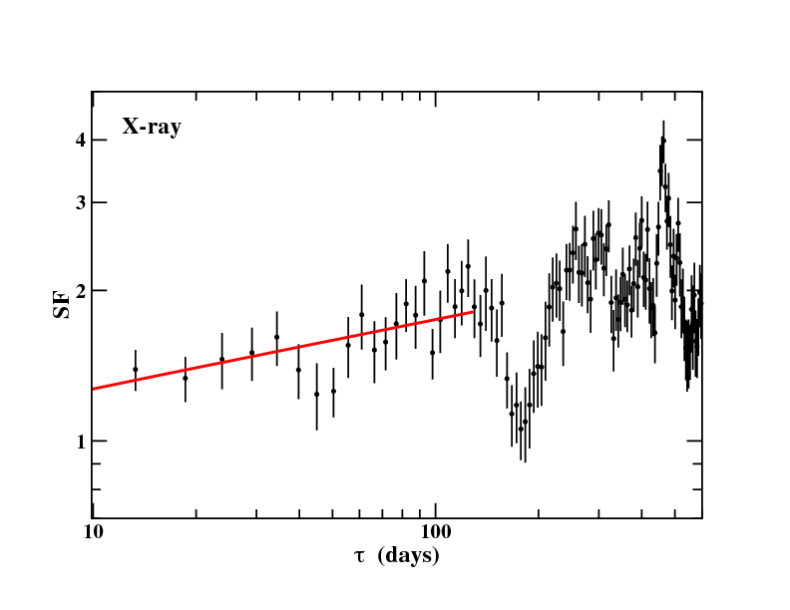
Mkn 335 Results
X-ray structure function extremely flat and noise dominated
Unable to constrain slope or characteristic timescale
Gallo, L., Blue, D.M. et al 2018

Slide 25
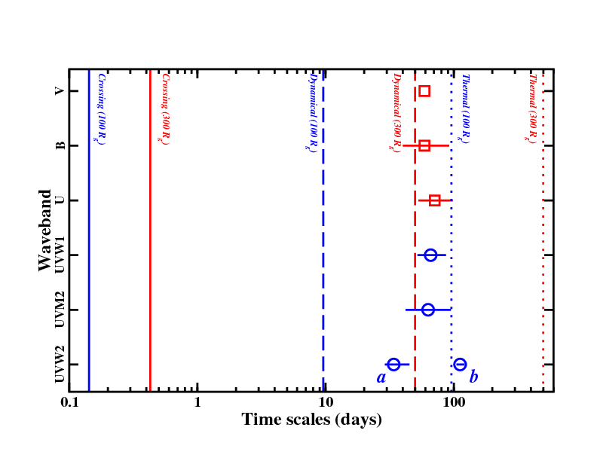
Mkn 335 Timescales
Standard accretion disc timescales calculated for comparison
Structure Function timescales plotted with two points for UVW2 representing the two characteristic timescales
Gallo, L., Blue, D.M. et al 2018

Slide 26
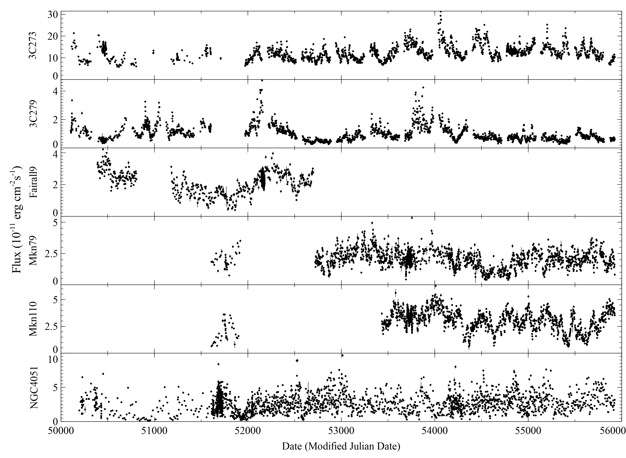
Current and Future Work
Data for 6 sources from the Rossi X-ray Timing Explorer (RXTE)
Initial structure functions not quite what was expected based on Gallo, Blue et al results

Slide 27
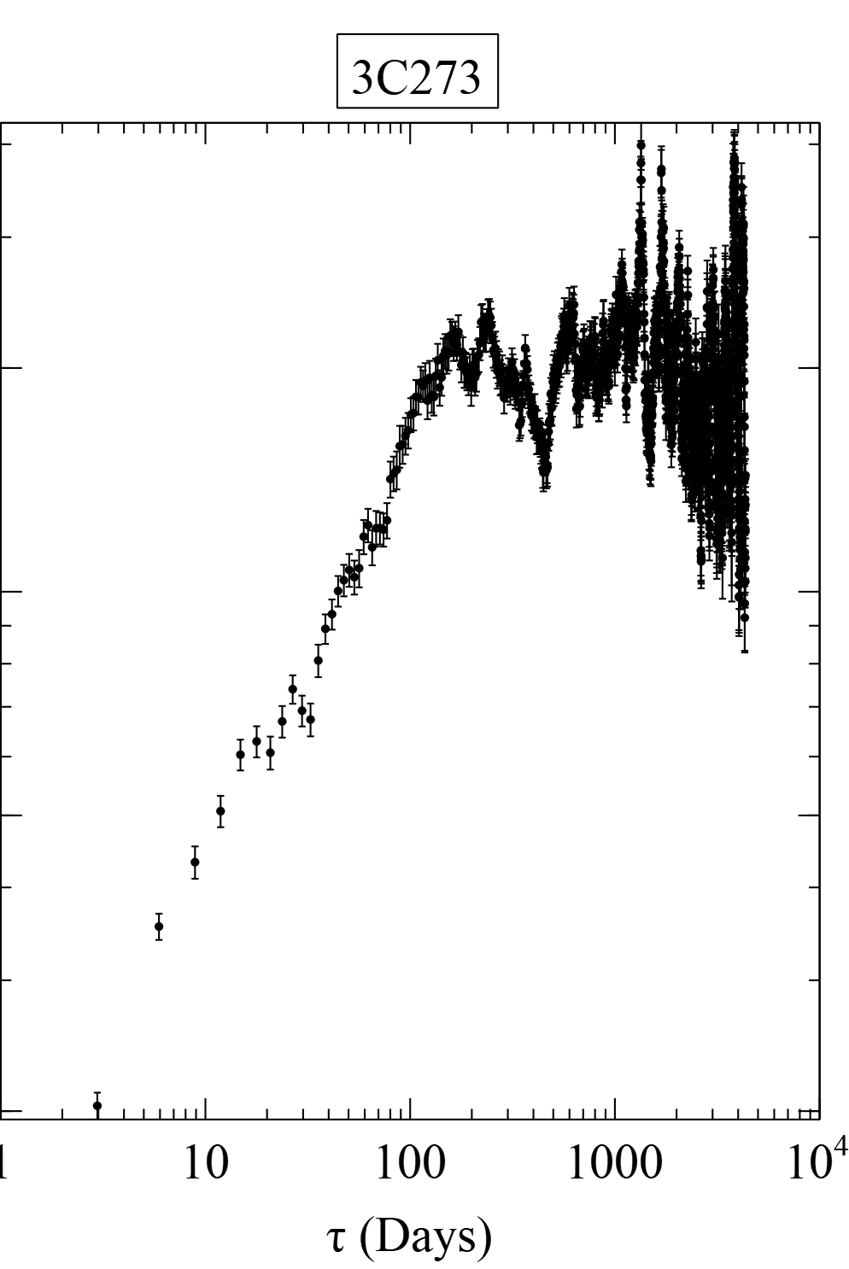
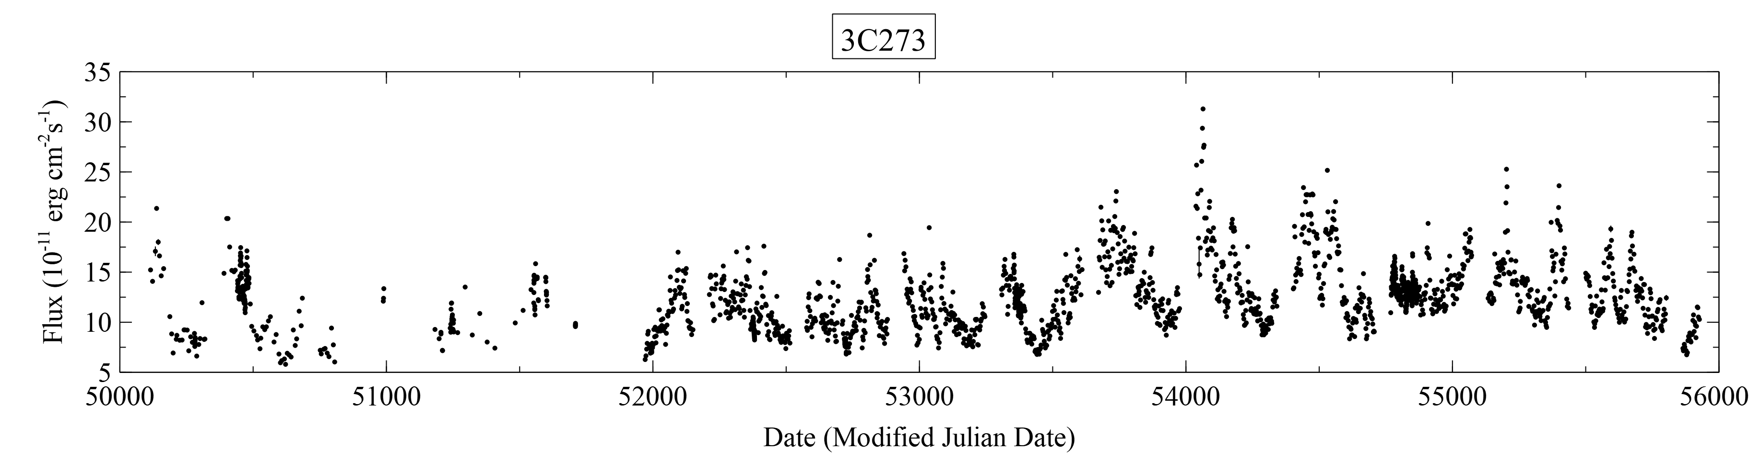
3C 273

Slide 28
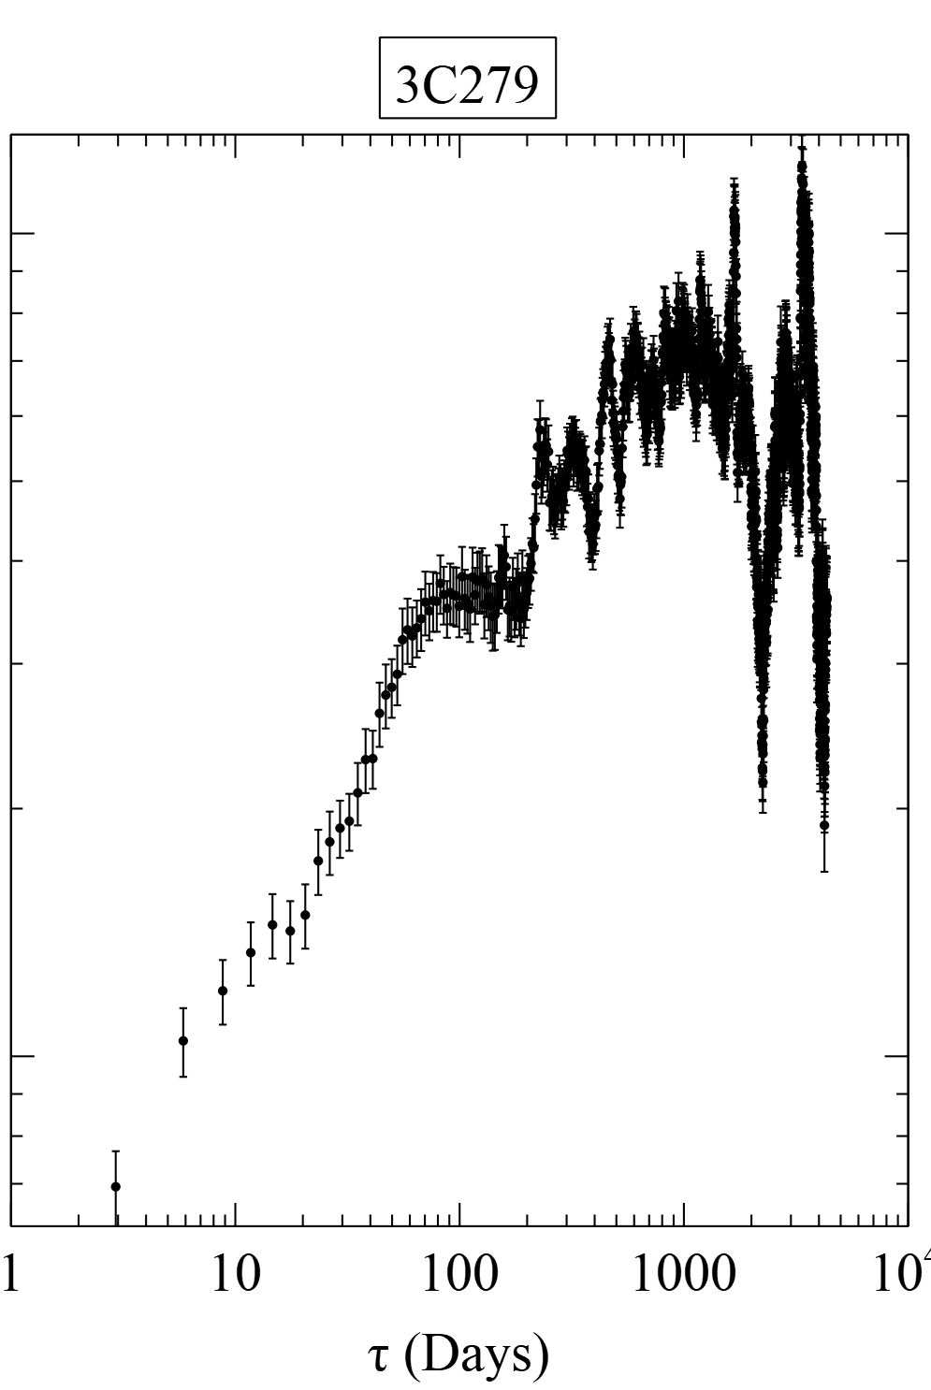
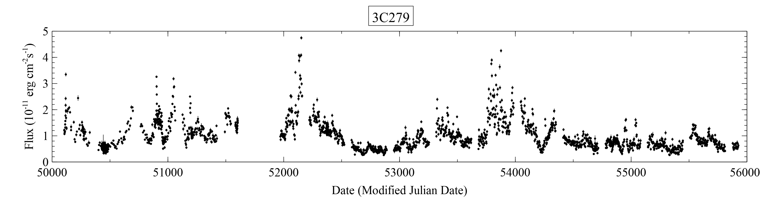
3C 279

Slide 29
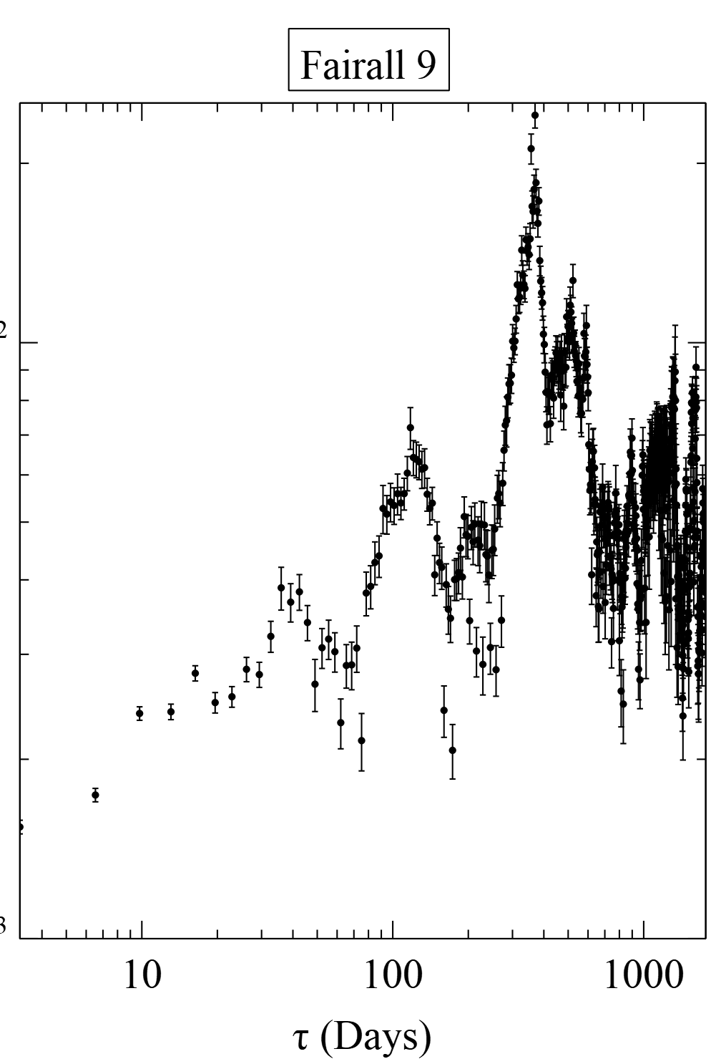
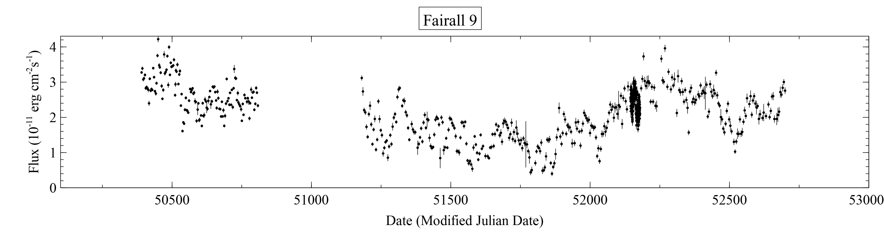
Fairall 9

Slide 30
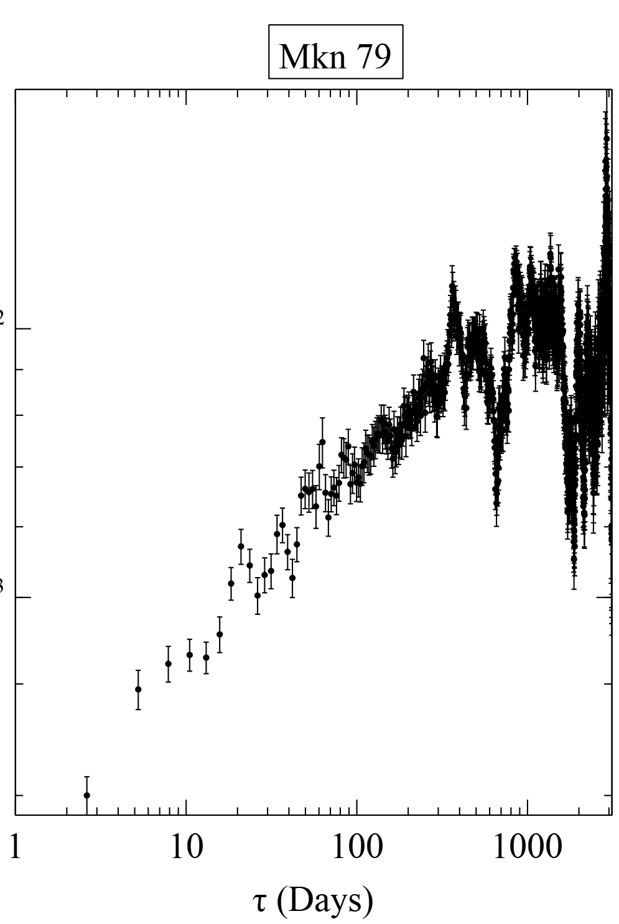
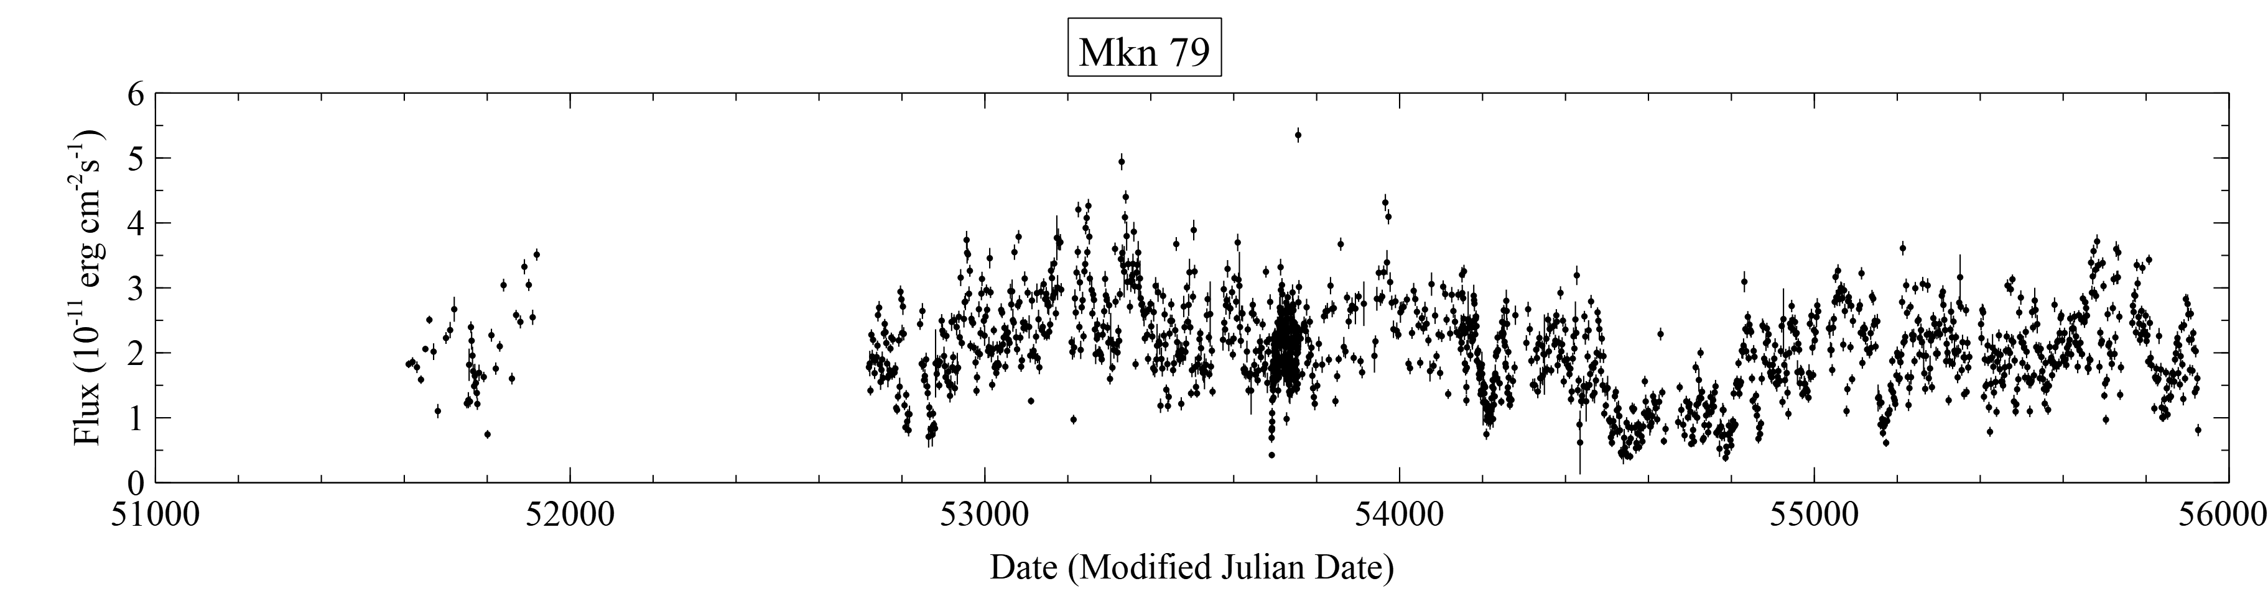
Mkn 79

Slide 31
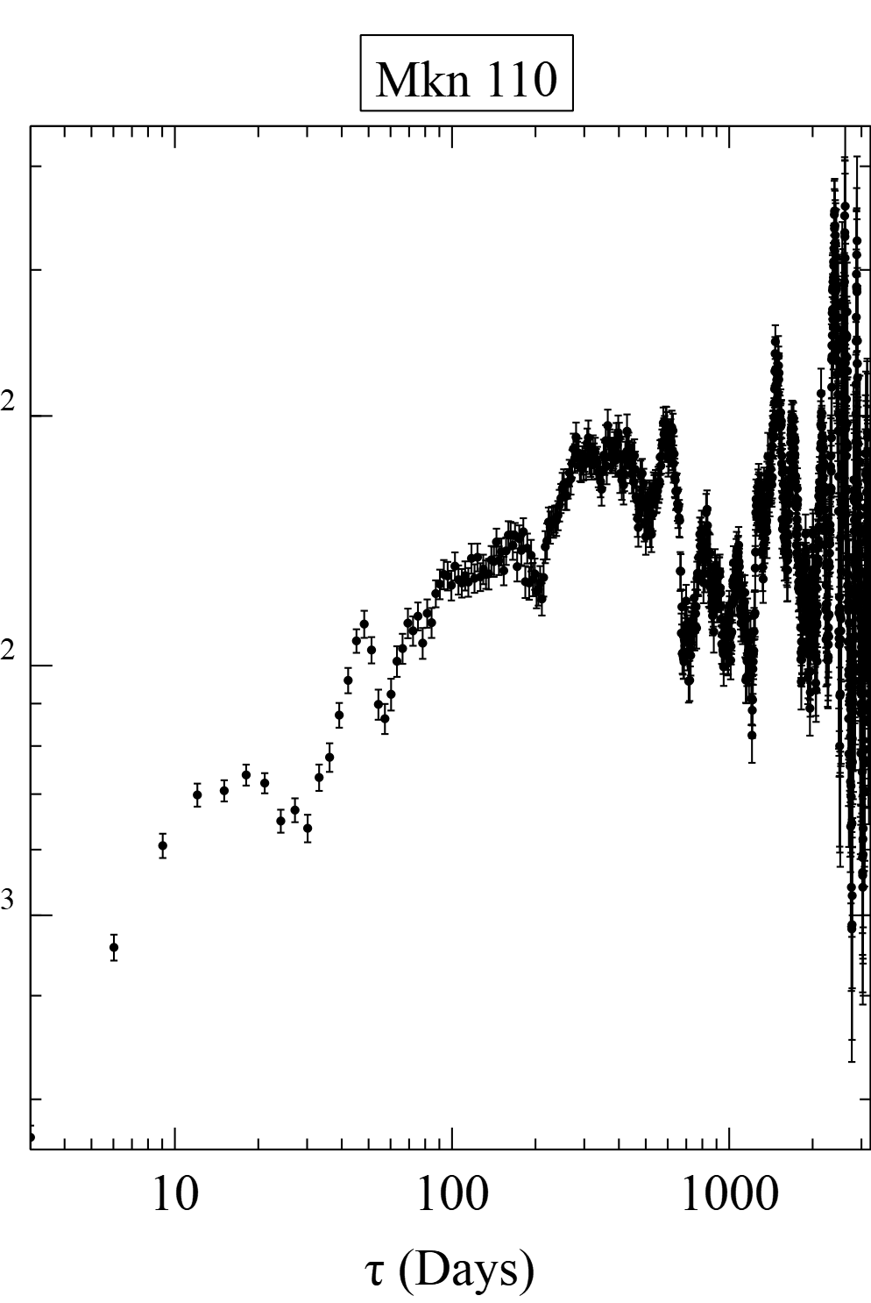
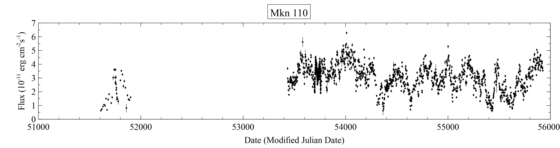
Mkn 110

Slide 32
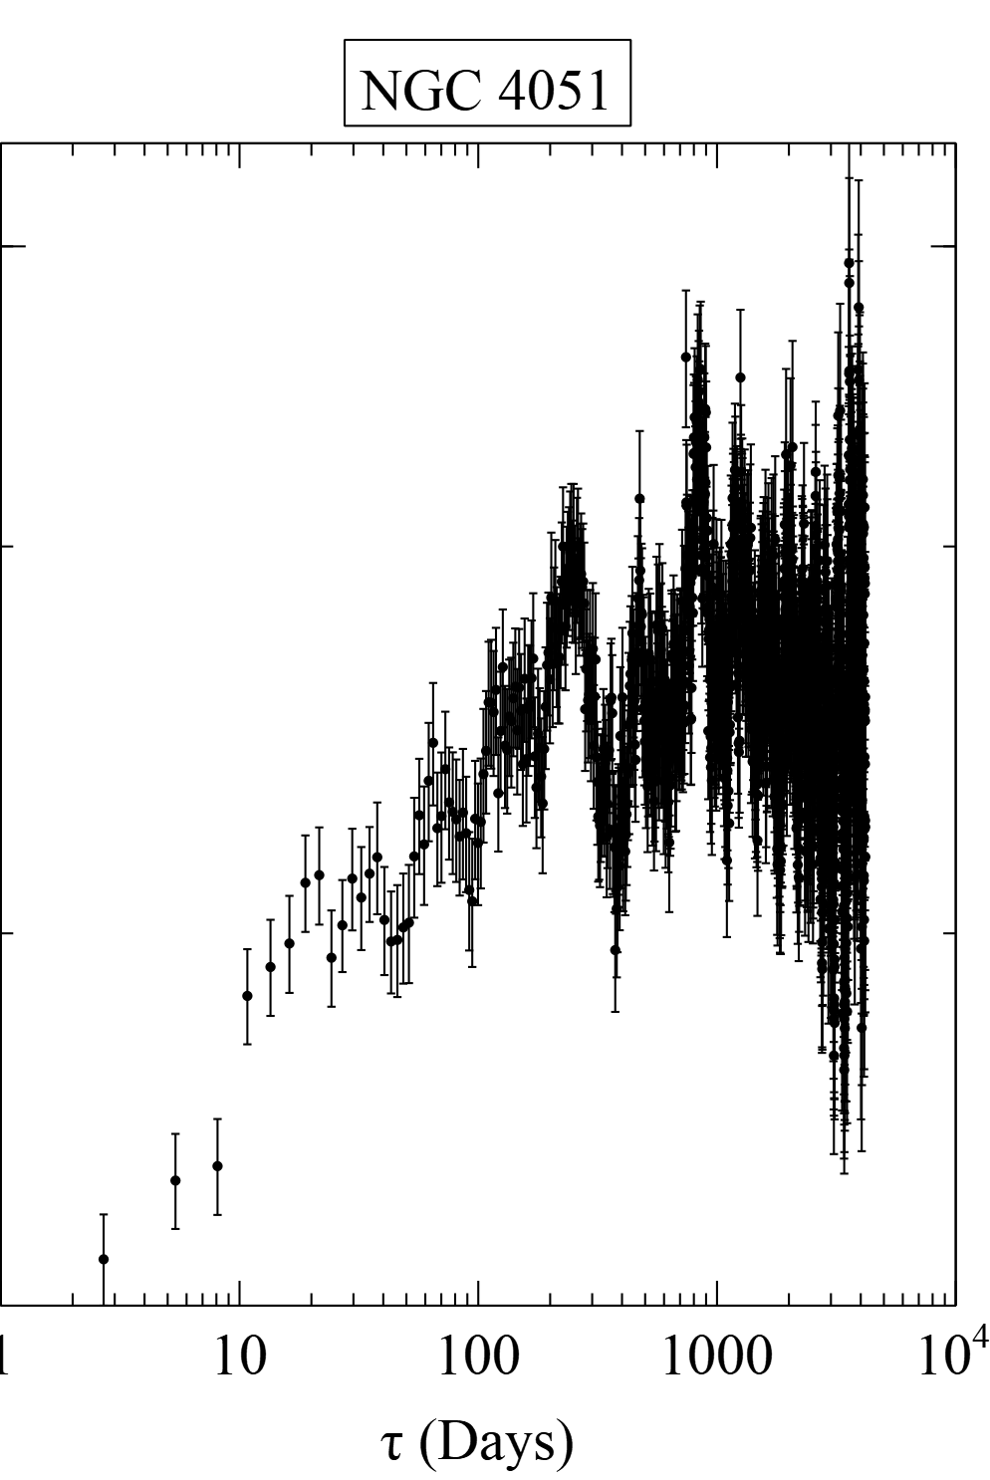
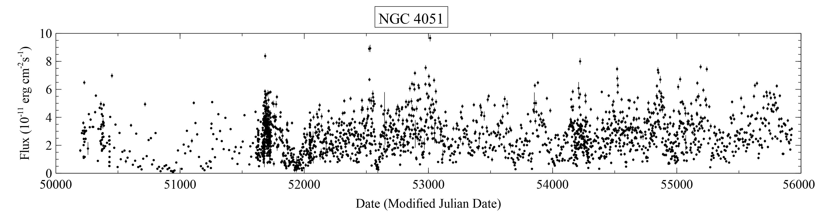
NGC 4051

Slide 33

Future Work
Image Credit: ESA/Hubble & NASA - https://www.spacetelescope.org/images/heic1110a/
Finish fitting and analysis for RXTE objects
Compare structure function in X-ray for RXTE objects to radio data for the same objects from Owens Valley Radio Observatory
Continued improvements and features for structure function program SFA
Further modeling and testing
Test with better sampled data, timescales of hours instead of days perhaps

Slide 34
Thanks and Acknowledgements
Dr. Tina Harriott
Dr. Luigi Gallo
Mount Saint Vincent University
Saint Mary’s University

Slide 35

Source List

Slide 36


Mkn 335 Results
Discrete Corelation Function used to search for corelations between bands
Peaks at 5±5 days, consistent with zero due to sampling resolution

Slide 37

Schwarzschild Solution
Illustration of the Schwarzschild solution showing the event horizon and the singularity.
Note that all light cones point inward inside the event horizon.
Credit: d’Inverno, R. (1993)

Slide 38

Kerr Solution
Simlulated ray tracing using Kerr-Newman solution
One of many simulations available at http://notizblock.yukterez.net/viewtopic.php?p=533
Video Credit: Yukterez (Simon Tyran, Vienna) - http://notizblock.yukterez.net/viewtopic.php?p=533

